Slide 1


Slide 2
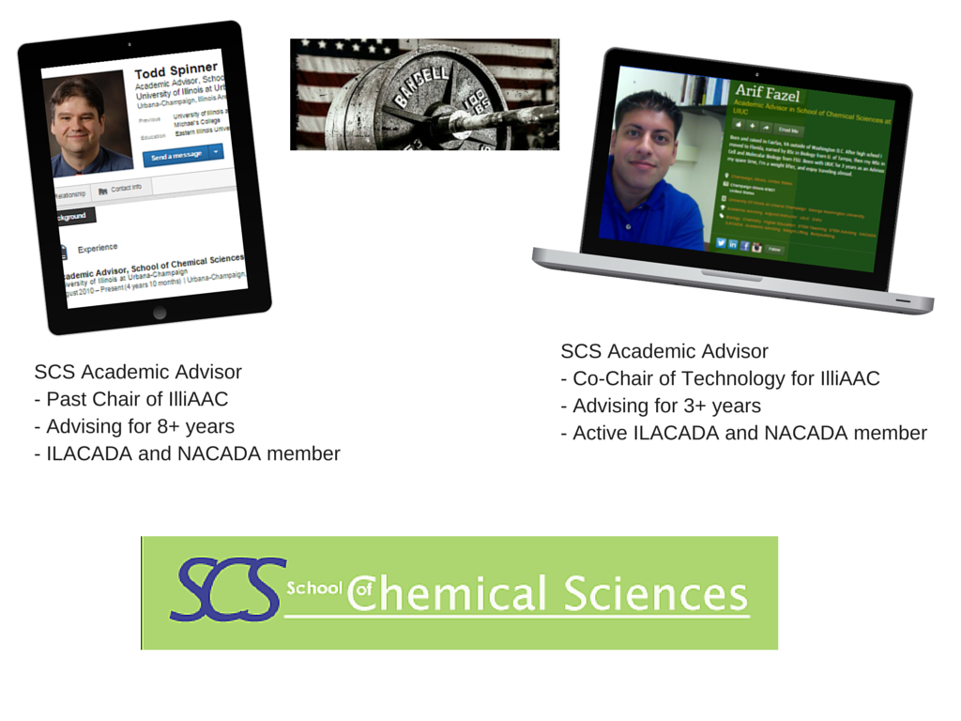
SCS Academic Advisor
Chair of IlliAAC
Advising for 8+ years
ILACADA and NACADA member

Slide 3

Notes:
Evolving to accommodate the up and coming tech generation

Slide 4

Notes:
Social media in advising
a. Facebook, Twitter, E-Newsletters and blogs have become the norm for getting information out to students.
b. Social Media and Tech should be used to supplement what we do as Advisors and not replace the face-to-face time.

Slide 5

Rules of Social Media

Slide 6
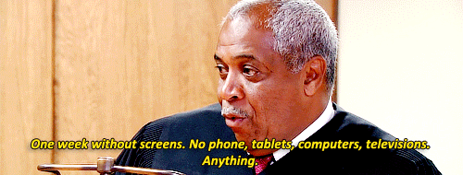

Students Get Most Of Their Information Electronically
From gossip to what professors to avoid or if there are seats open in a course.
Students are more likely to get this information via social media.
Notes:
Discuss how Advisors can get involved by providing more solid information through social media channels, and letting students know that they should visit or contact their advisor for information on courses and checking on progress they are making rather than relying solely on friends or social media channels. Maintaining a running blog that can be updated regulalry and then shared via social media may be the best way, will also let students know that you are reliable and up to date with both sound information and tech trends.

Slide 7
Tools To Help Keep The Advisor Organized
PushBullet
www.pushbullet.com
Connects through your Google account and any linked devices.
Get your mobile notifications sent to your computer when working and respond as well.
Find an interesting article on the way to work? Push it to your computer and read it when you get to the office.
Notes:
Sidekick, Google: Keep and Drive, tweetcaster, pushbullet, hootsuite.

Slide 8

GPA Calculator Tools
  Improvement Calculator or website of truth!
  Grade Replacement Calculator
  There is a 2nd chance!

Slide 9








Advising with Video

Slide 10
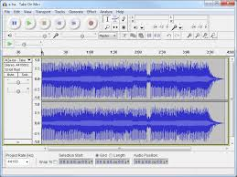

Audio Editing Tools

Slide 11
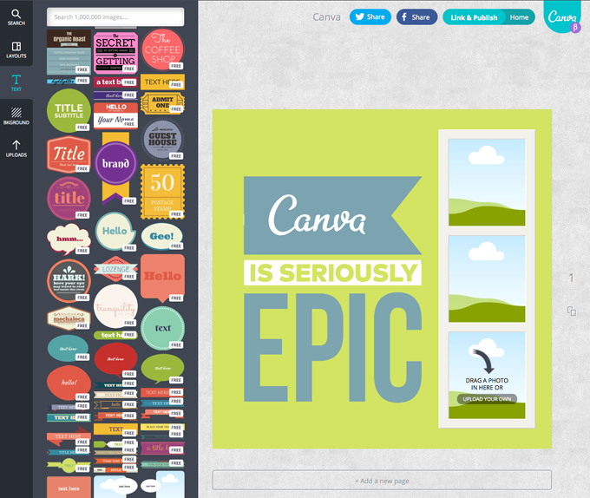

InfoGraphic Editing Tools
https://www.canva.com/create/infographics/ ; easy to make infographics

Slide 12

Graphics Editing Tools

Slide 13





Tools to Create Videos
Open Broadcaster Software
Free, open source software for live streaming and recording

Slide 14



Video Creation Suggestions
BEFORE YOU START REMEMBER:
Write Script
Record Voiceover
Add Visuals
Keep under 5 Minutes unless your name is Jerry Seinfeld!

Slide 15
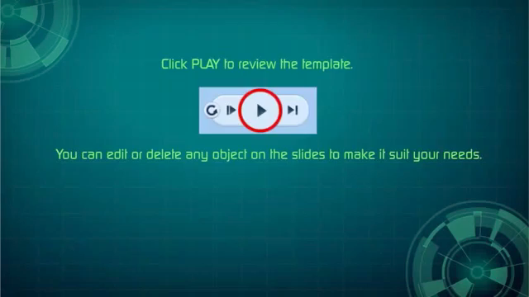
Example

Slide 16

Example

Slide 17
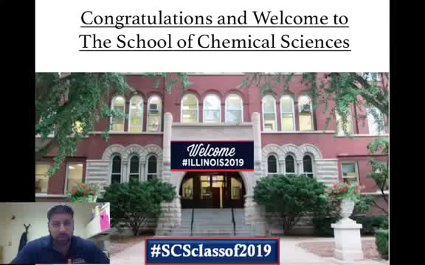
Open Broadcast Software

Slide 18


