Slide 1
Positive Wellbeing, Mental Health and Self-Care for Social Media and Web Professionals
Presented by: Todd Spinner
Senior Academic Advisor, School of Chemical Sciences
University of Illinois at Urbana-Champaign
spinner@illinois.edu

Slide 2
Trigger Warning:
Please note: This presentation on mental health may contain a discussion of various mental health disorders, depression, self-injurious behavior, etc. that may acts as triggers for some. Continue at your own discretion and consider another presentation if this may be troubling for you.

Slide 3

Learning objectives
Discuss how pressure to do more with less is pushing people to be become overwhelmed, stressed, burned out and less effective.
Introduce the concept of less is more though the philosophy of minimalism and essentialism.
Look at how modern minimalist literature can lead to advisors making better decisions and assist in leading a purposeful life based on values.
Discuss strategies that advisors can use to implement to lead a meaningful purpose driven life.
Pixabay user:

Slide 4
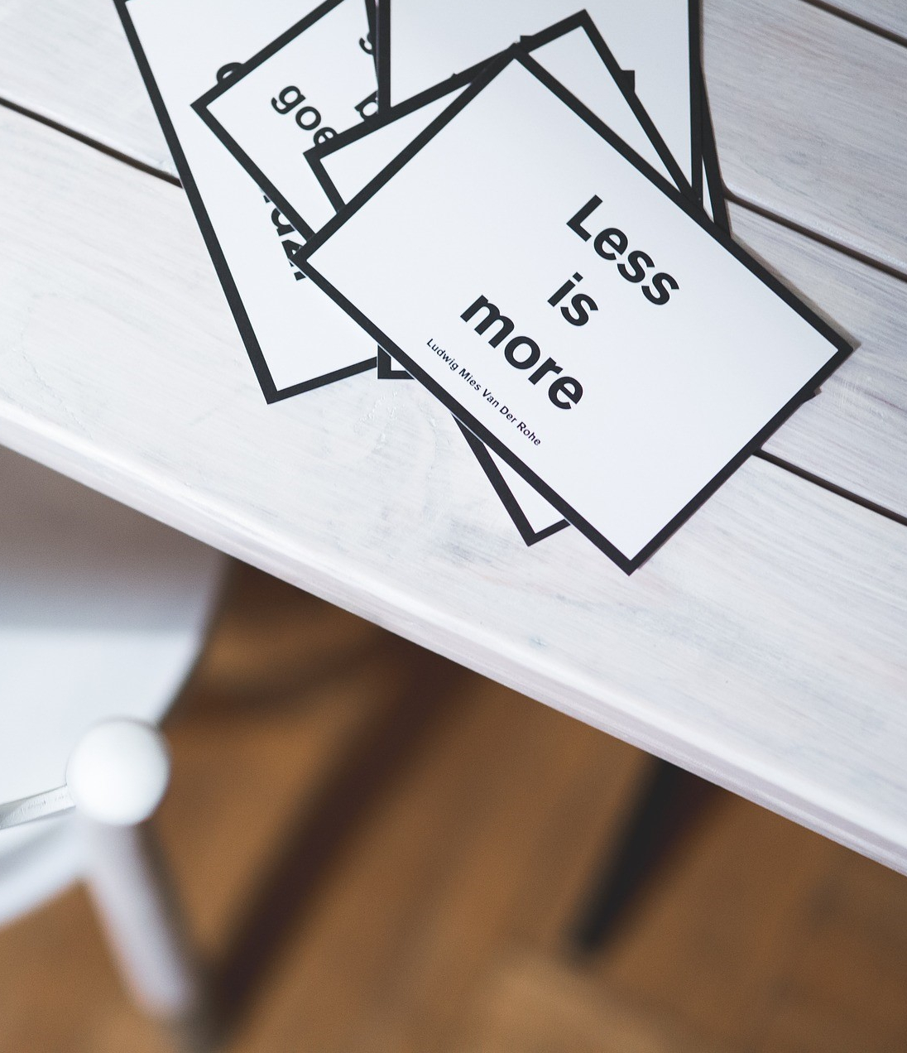
Student Tasks
What are some of the things you have to do as a student?
What are some additional roles
and responsibilities that we may have chosen to take on?
Image by Karolina Grabowska from Pixabay

Slide 5
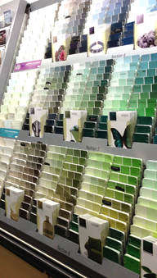
My story
Holden, C. (n.d.). Studio Update: Valspar Paint. Retrieved December 12, 2017, from http://inspiredbarn.com/2013/01/studio-update-valspar-paint/

Slide 6
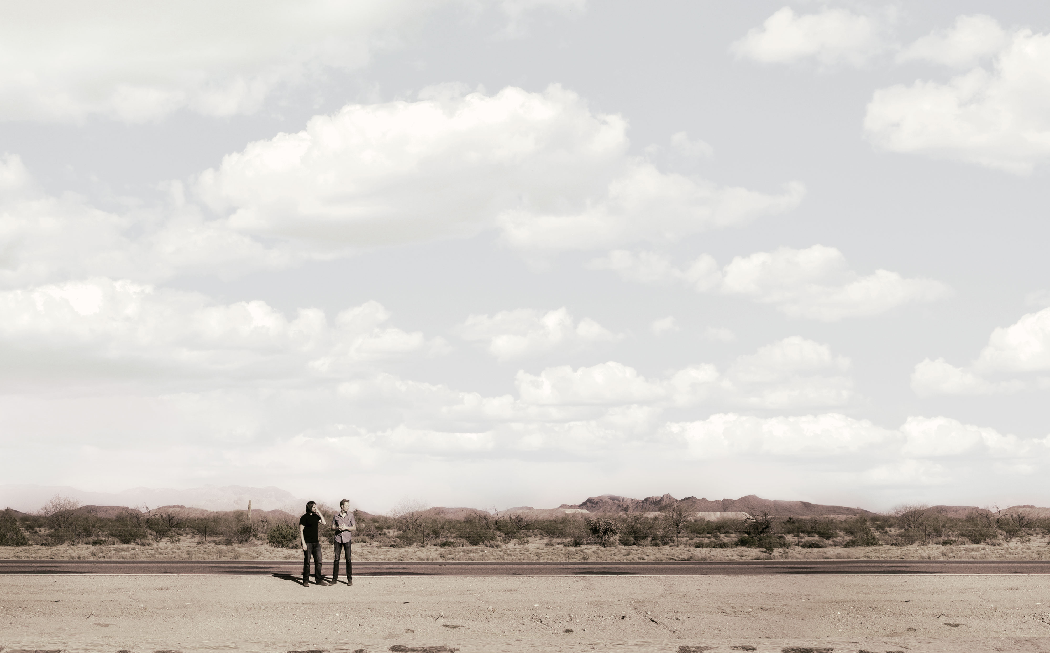


Is minimalism the answer?
project title
project tile
project title

Slide 7
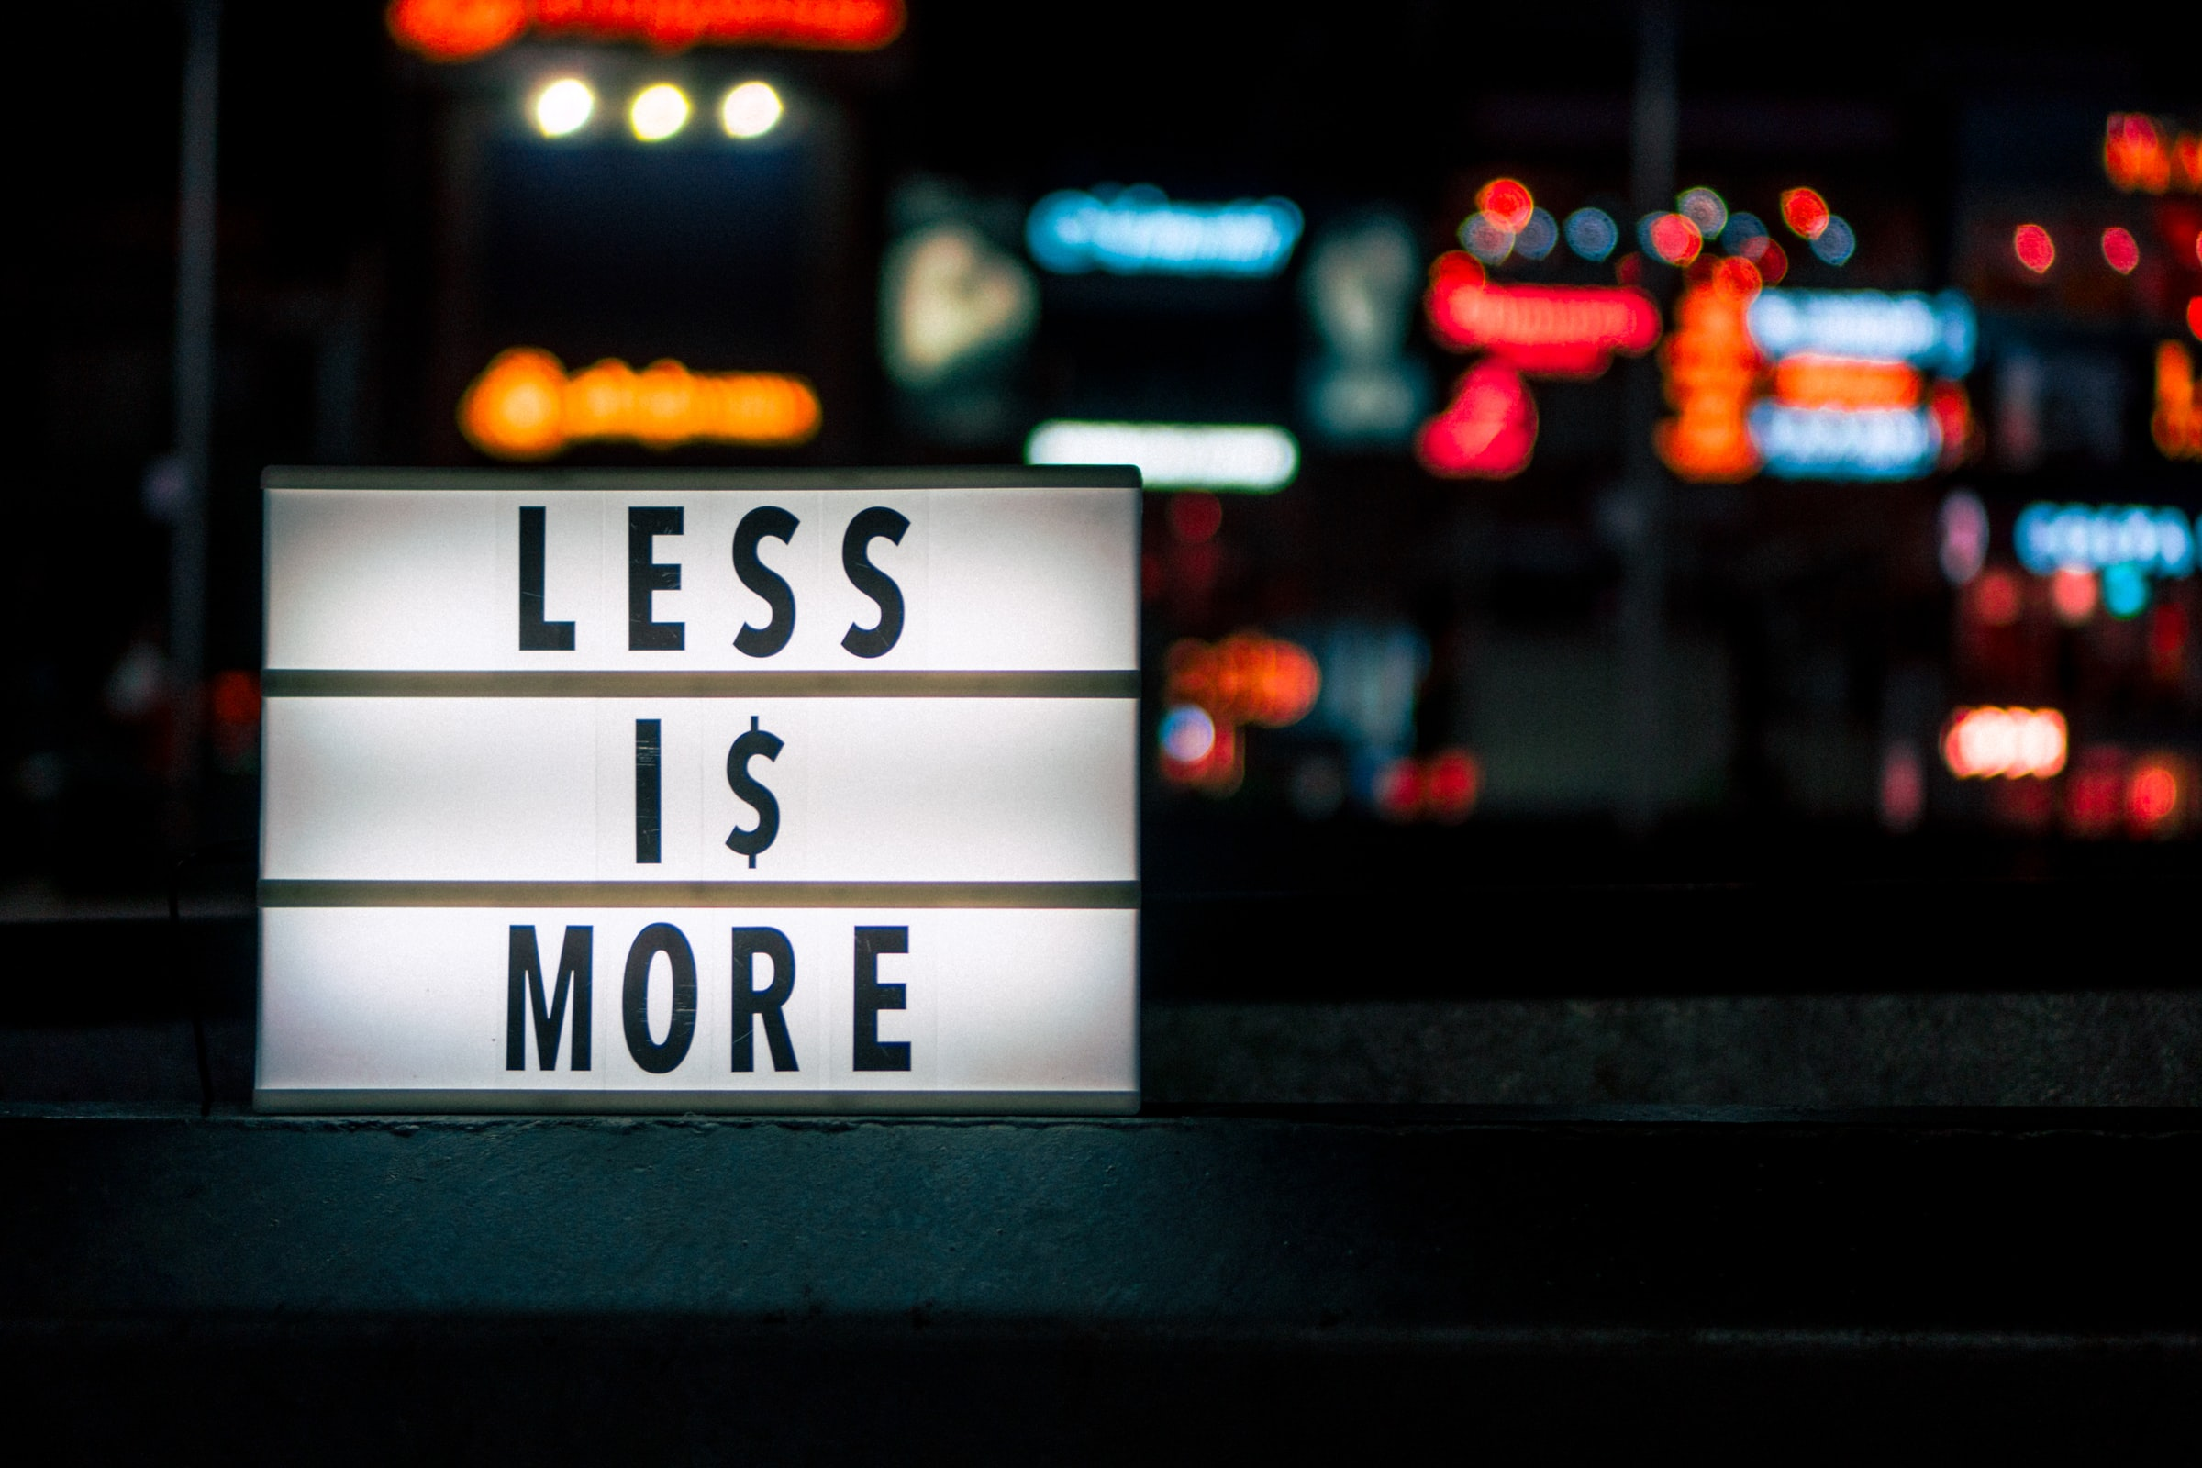
Is Minimalism the Answer?
+Less is More, Prateek Katyal (2019). Retrieved September 1,2021, from https://unsplash.com/photos/MGRv3qZfyTs

Slide 8
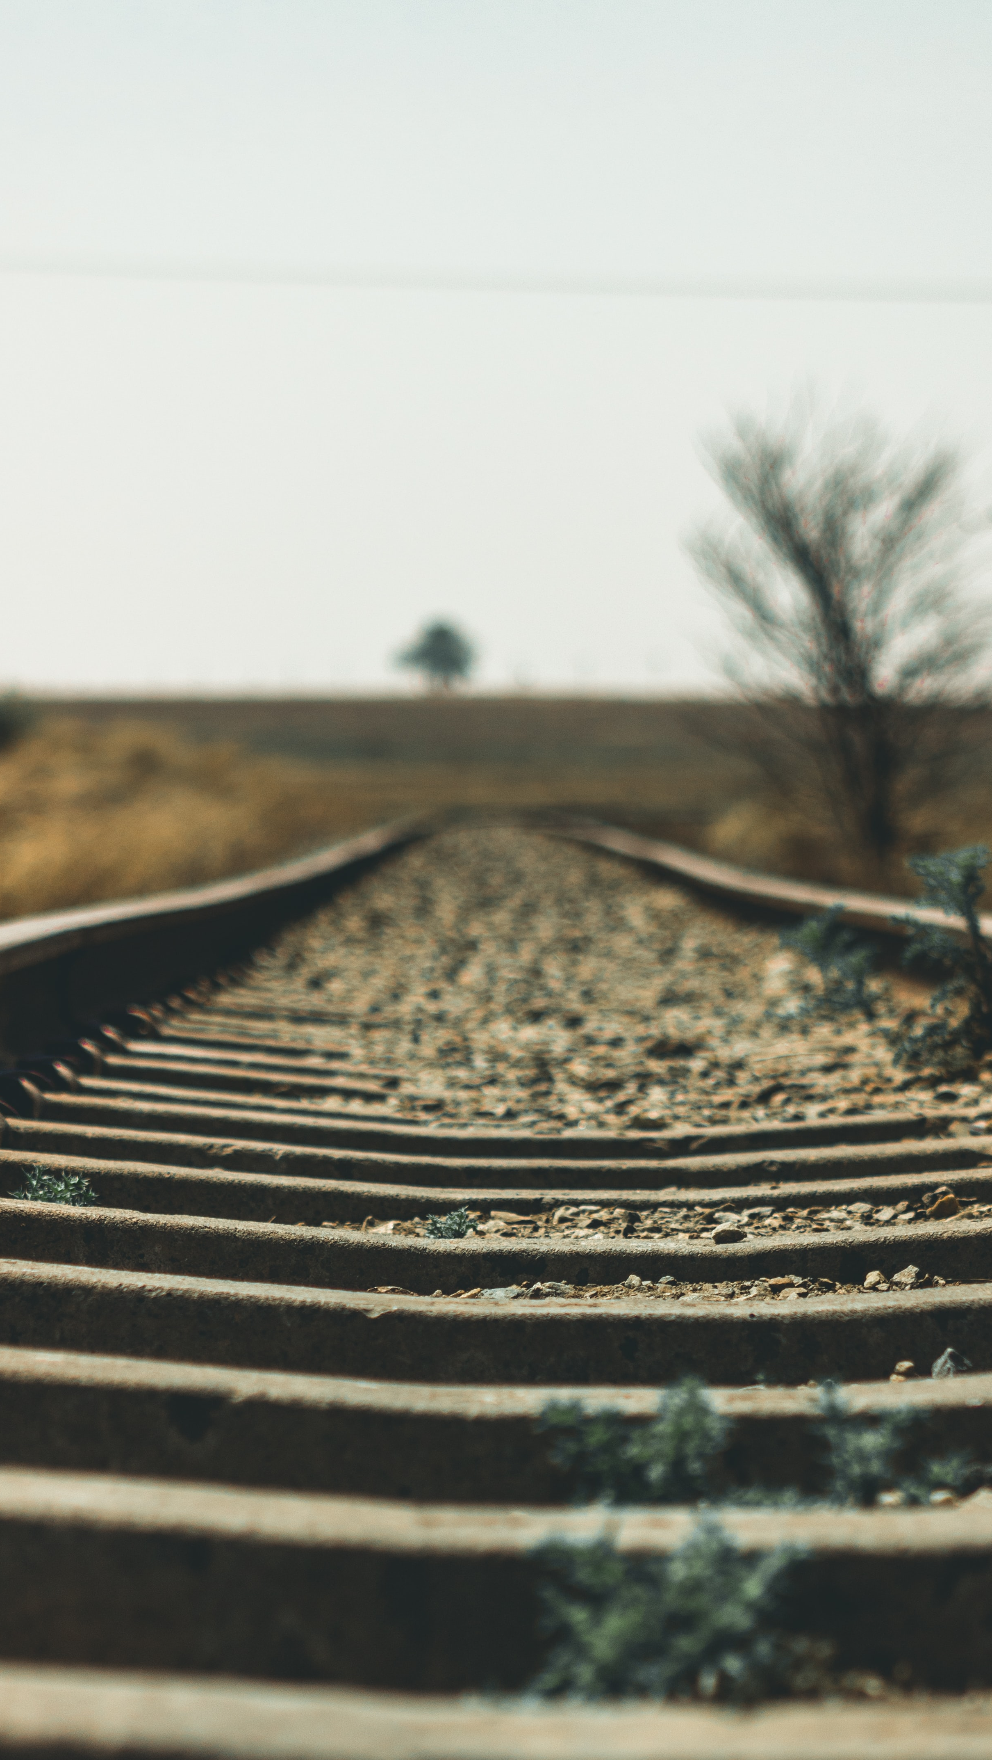
What is Minimalism?
Photo by Tembinkosi Sikupela on Unsplash

Slide 9
Minimal adj.
min·i·mal | \ ˈmi-nə-məl \
Definition of minimal
1 : relating to or being a minimum: such as
a : the least possible a victory won with minimal loss of life
b : barely adequate a minimal standard of living
c : very small or slight a minimal interest in art
2 often capitalized : of, relating to, or being minimal art or minimalism
Maybe a definition isn’t the best place to start.
Source: https://www.merriam-webster.com/dictionary/minimal

Slide 10
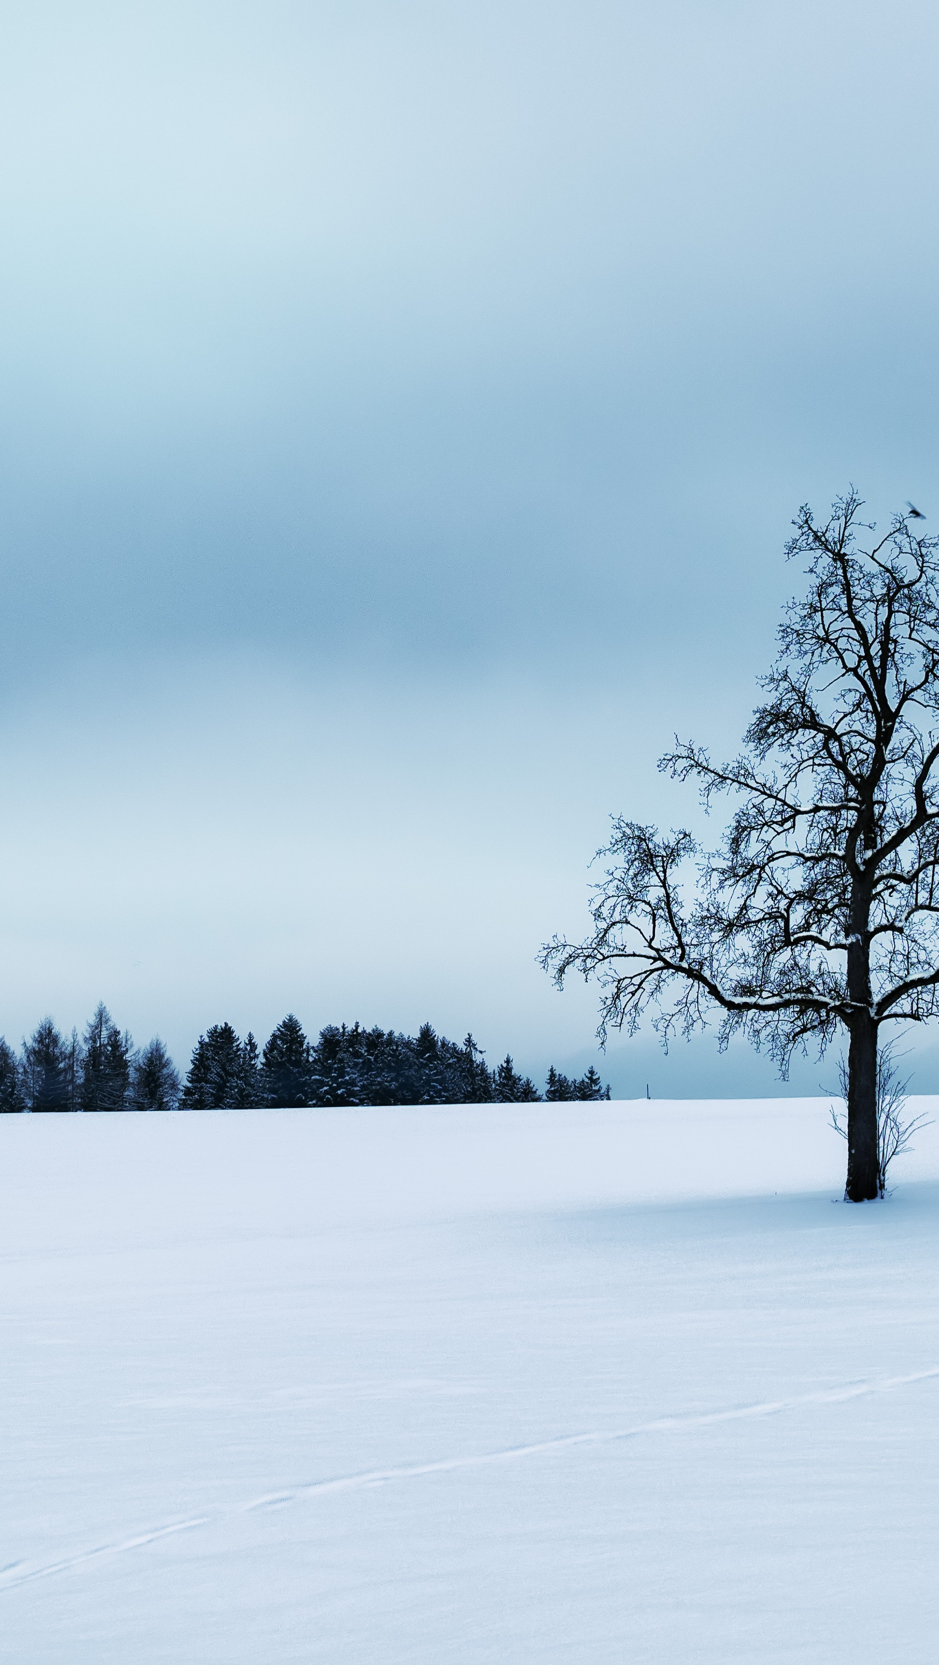
“What Minimalism is really all about is reassessment of your priorities so that you can strip away the excess stuff – the possessions and ideas and relationships and activities – that don’t bring value to your life.” ~Colin Wright
“Minimalism is a tool to rid yourself of life’s excess in favor of focusing on what’s important—so you can find happiness, fulfillment, and freedom.” ~ Millburn & Nicodemus
Quotes from NACADA Conference 2017 C230-H01

Slide 11
What Society Tells Us
Do More with Less
Look what Dr., Mr. or Ms. Jones is doing or has.
You can sleep when you are dead
Seize the Day
The American Dream can be earned and purchased at ……
You can have it all

Slide 12
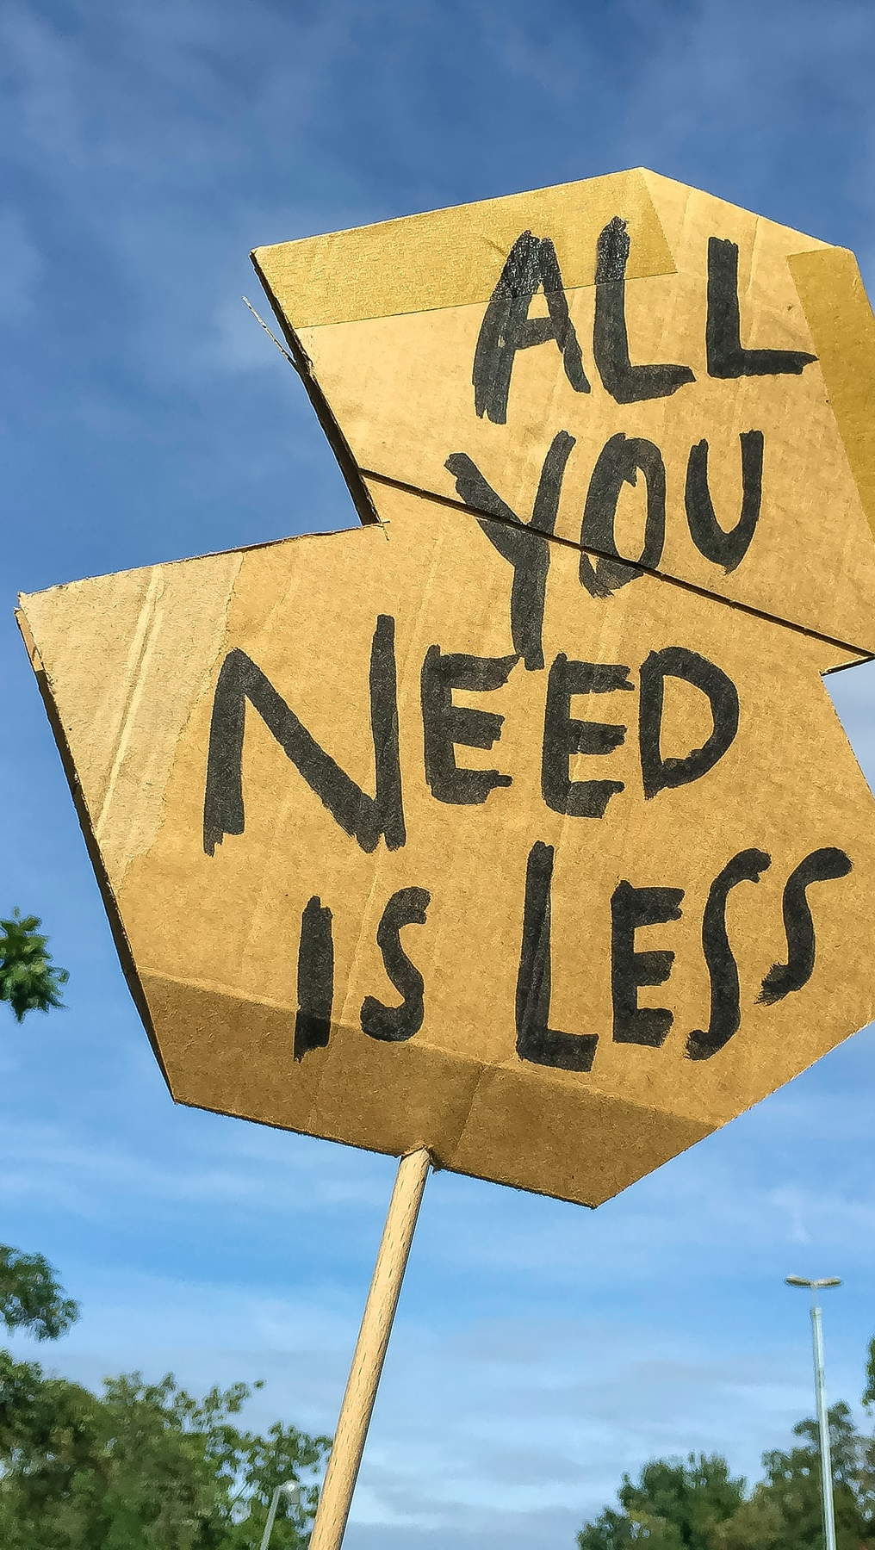
Essentialism: The Disciplined Pursuit of Less
Ask yourself these questions:
Did you answer yes to any of these?
Essentialism may be your answer.
From Greg McKeown’s Book Essentialism: The Disciplined Pursuit of Less
Photo by Etienne Girardet on Unsplash

Slide 13
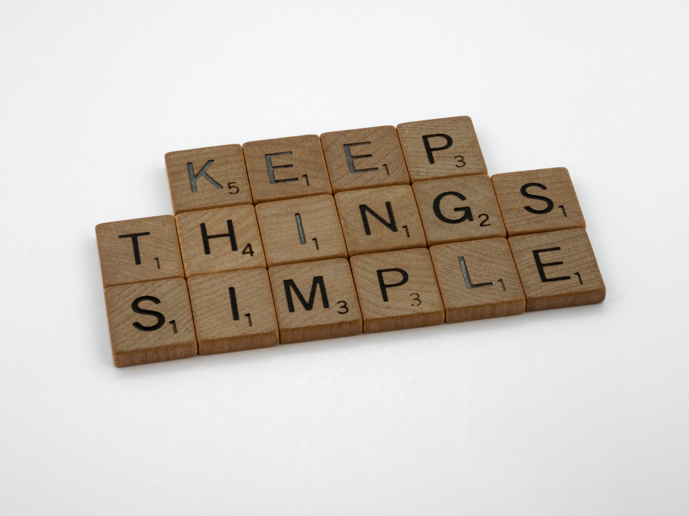
Non-essentialism vs. Essentialism
Photo by Brett Jordan on Unsplash
From pg. 8 of Greg McKeown’s Book Essentialism: The Disciplined Pursuit of Less

Slide 14
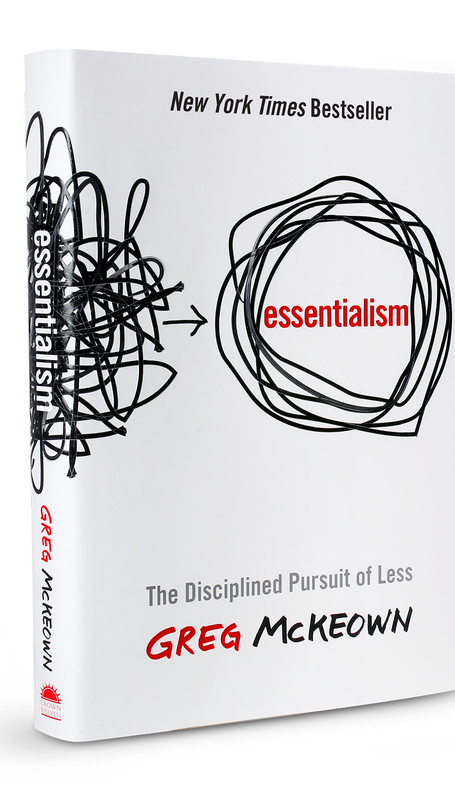
Essentialism: The Disciplined Pursuit of Less
Have you ever found yourself stretched too thin?
Do you sometimes feel overworked and underutilized?
Do you feel motion sickness instead of momentum?
Does your day sometimes get hijacked by someone else’s agenda?
Have you ever said “yes” simply to please and then resented it?
If you answered yes to any of these, the way out is the Way of the Essentialist.

Slide 15
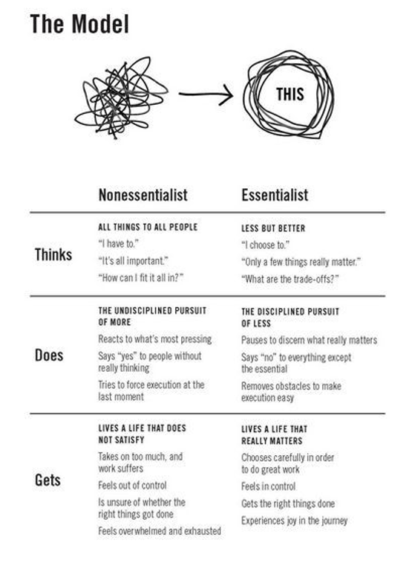
From pg. 8 of Greg McKeown’s Book Essentialism: The Disciplined Pursuit of Less

Slide 16
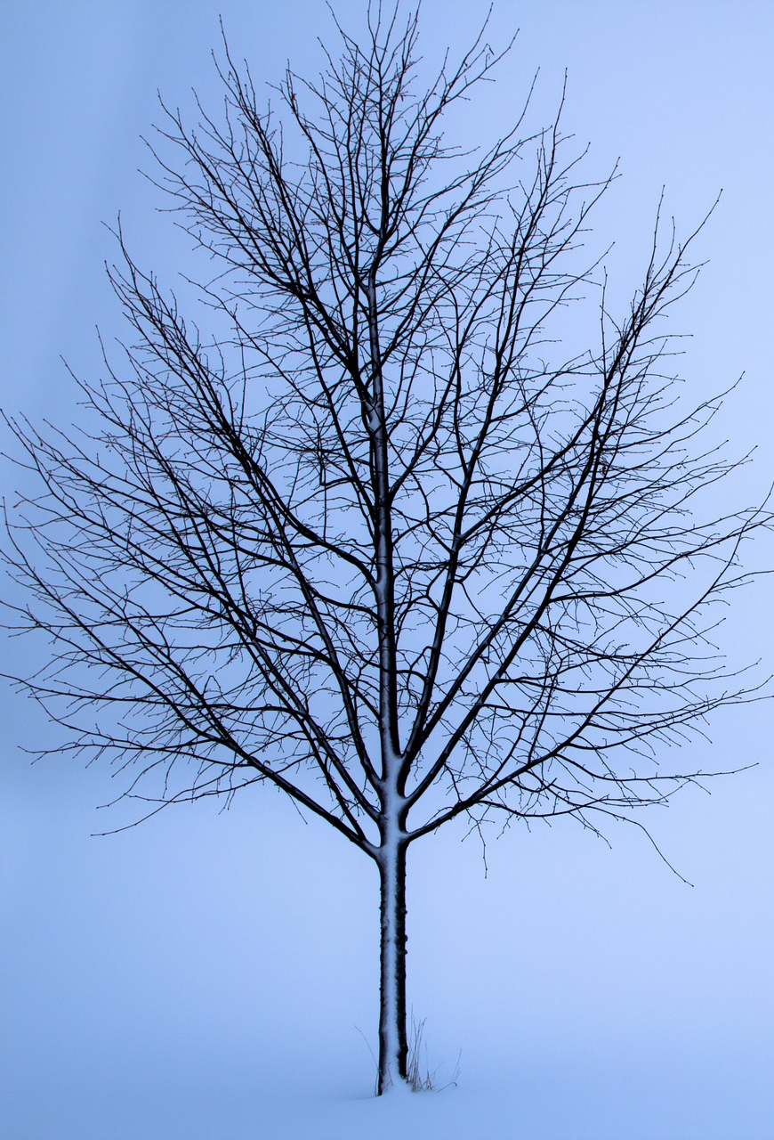
What is clear is that if you don’t prioritize your life, someone else will.
Image by Henning Sørby from Pixabay

Slide 17
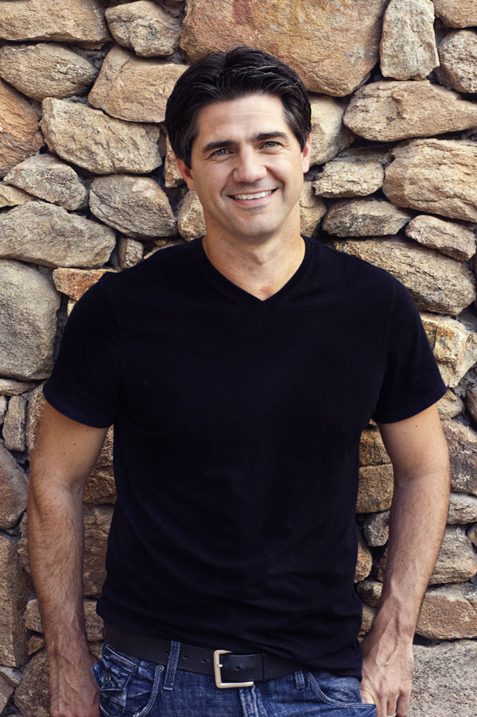
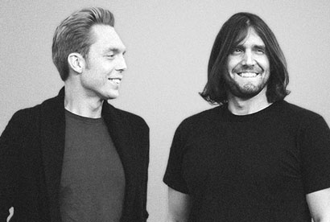
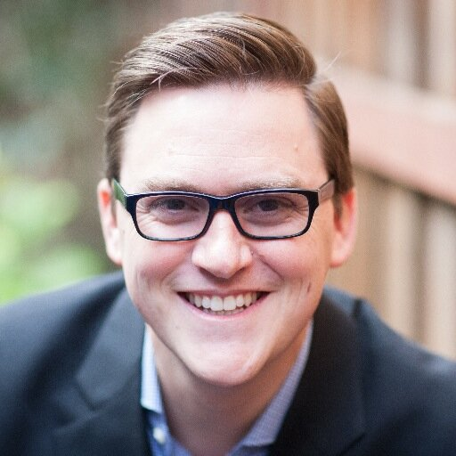
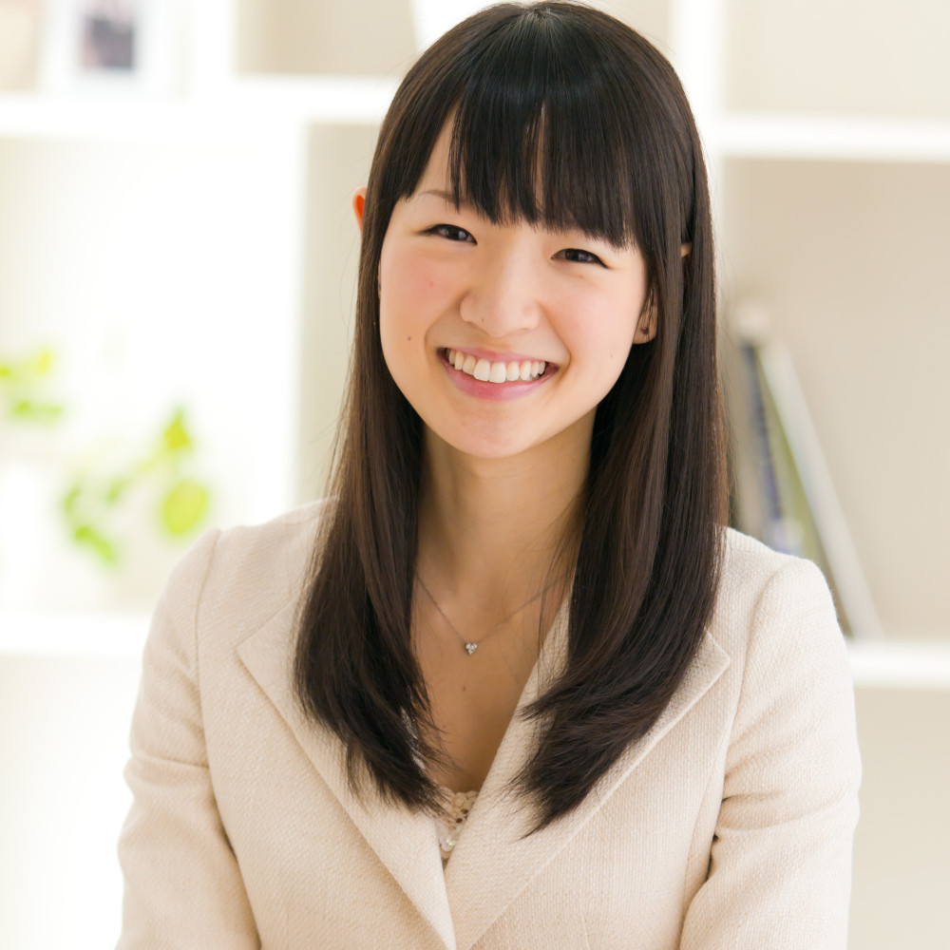
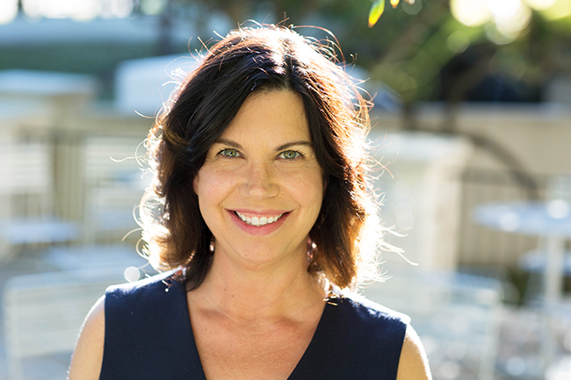
The Leading Minimalists
Joshua Becker
Joshua Fields Milburn and Ryan Nicodemus
Greg McKeown
Marie Kondo
Joshua Becker - https://www.becomingminimalist.com
Joshua Fields Milburn and Ryan Nicodemus - https://www.theminimalists.com/
Greg McKeown - https://gregmckeown.com/
Marie Kondo - http://tidyingup.com/
Courtney Carver - https://bemorewithless.com/ (Project 333)
Pictures courtesy of their respective websites.
Courtney Carver

Slide 18
What are your values?
What are your primary tasks at work?
Have you articulated an personal and professional philosophy?
Are you living your values personally and professionally?
“You’re only as strong as your weakest value.” Joshua Fields Millburn
Nicodemus, R. (n.d.). Ryan Nicodemus's Blog, page 42. Goodreads. https://www.goodreads.com/author/show/5235290.Ryan_Nicodemus/blog?page=42.

Slide 19
Mental Load
Too many things to do, and too much clutter can leave us feeling stressed, anxious, tired, overwhelmed.
Notes:
Say Yes to everything – Easy Reward/Instant Gratification. Long Term Discontent
Say No – Regret for a Few minutes –

Slide 20
No
Look at being overwhelmed like a flashing yellow light: use caution when saying ‘yes’ to others and tasks. —Ryan Nicodemus
“Busy for the sake of busy is, by definition, unfocused, which makes it impossible to discern that which
matters most amid the blur.” — Joshua Fields Millburn
Don’t just say ‘no’ for the sake of saying ‘no’—be clear on what you’re saying ‘yes’ to.
—Ryan Nicodemus
Notes:
Say Yes to everything – Easy Reward/Instant Gratification. Long Term Discontent
Say No – Regret for a Few minutes –

Slide 21
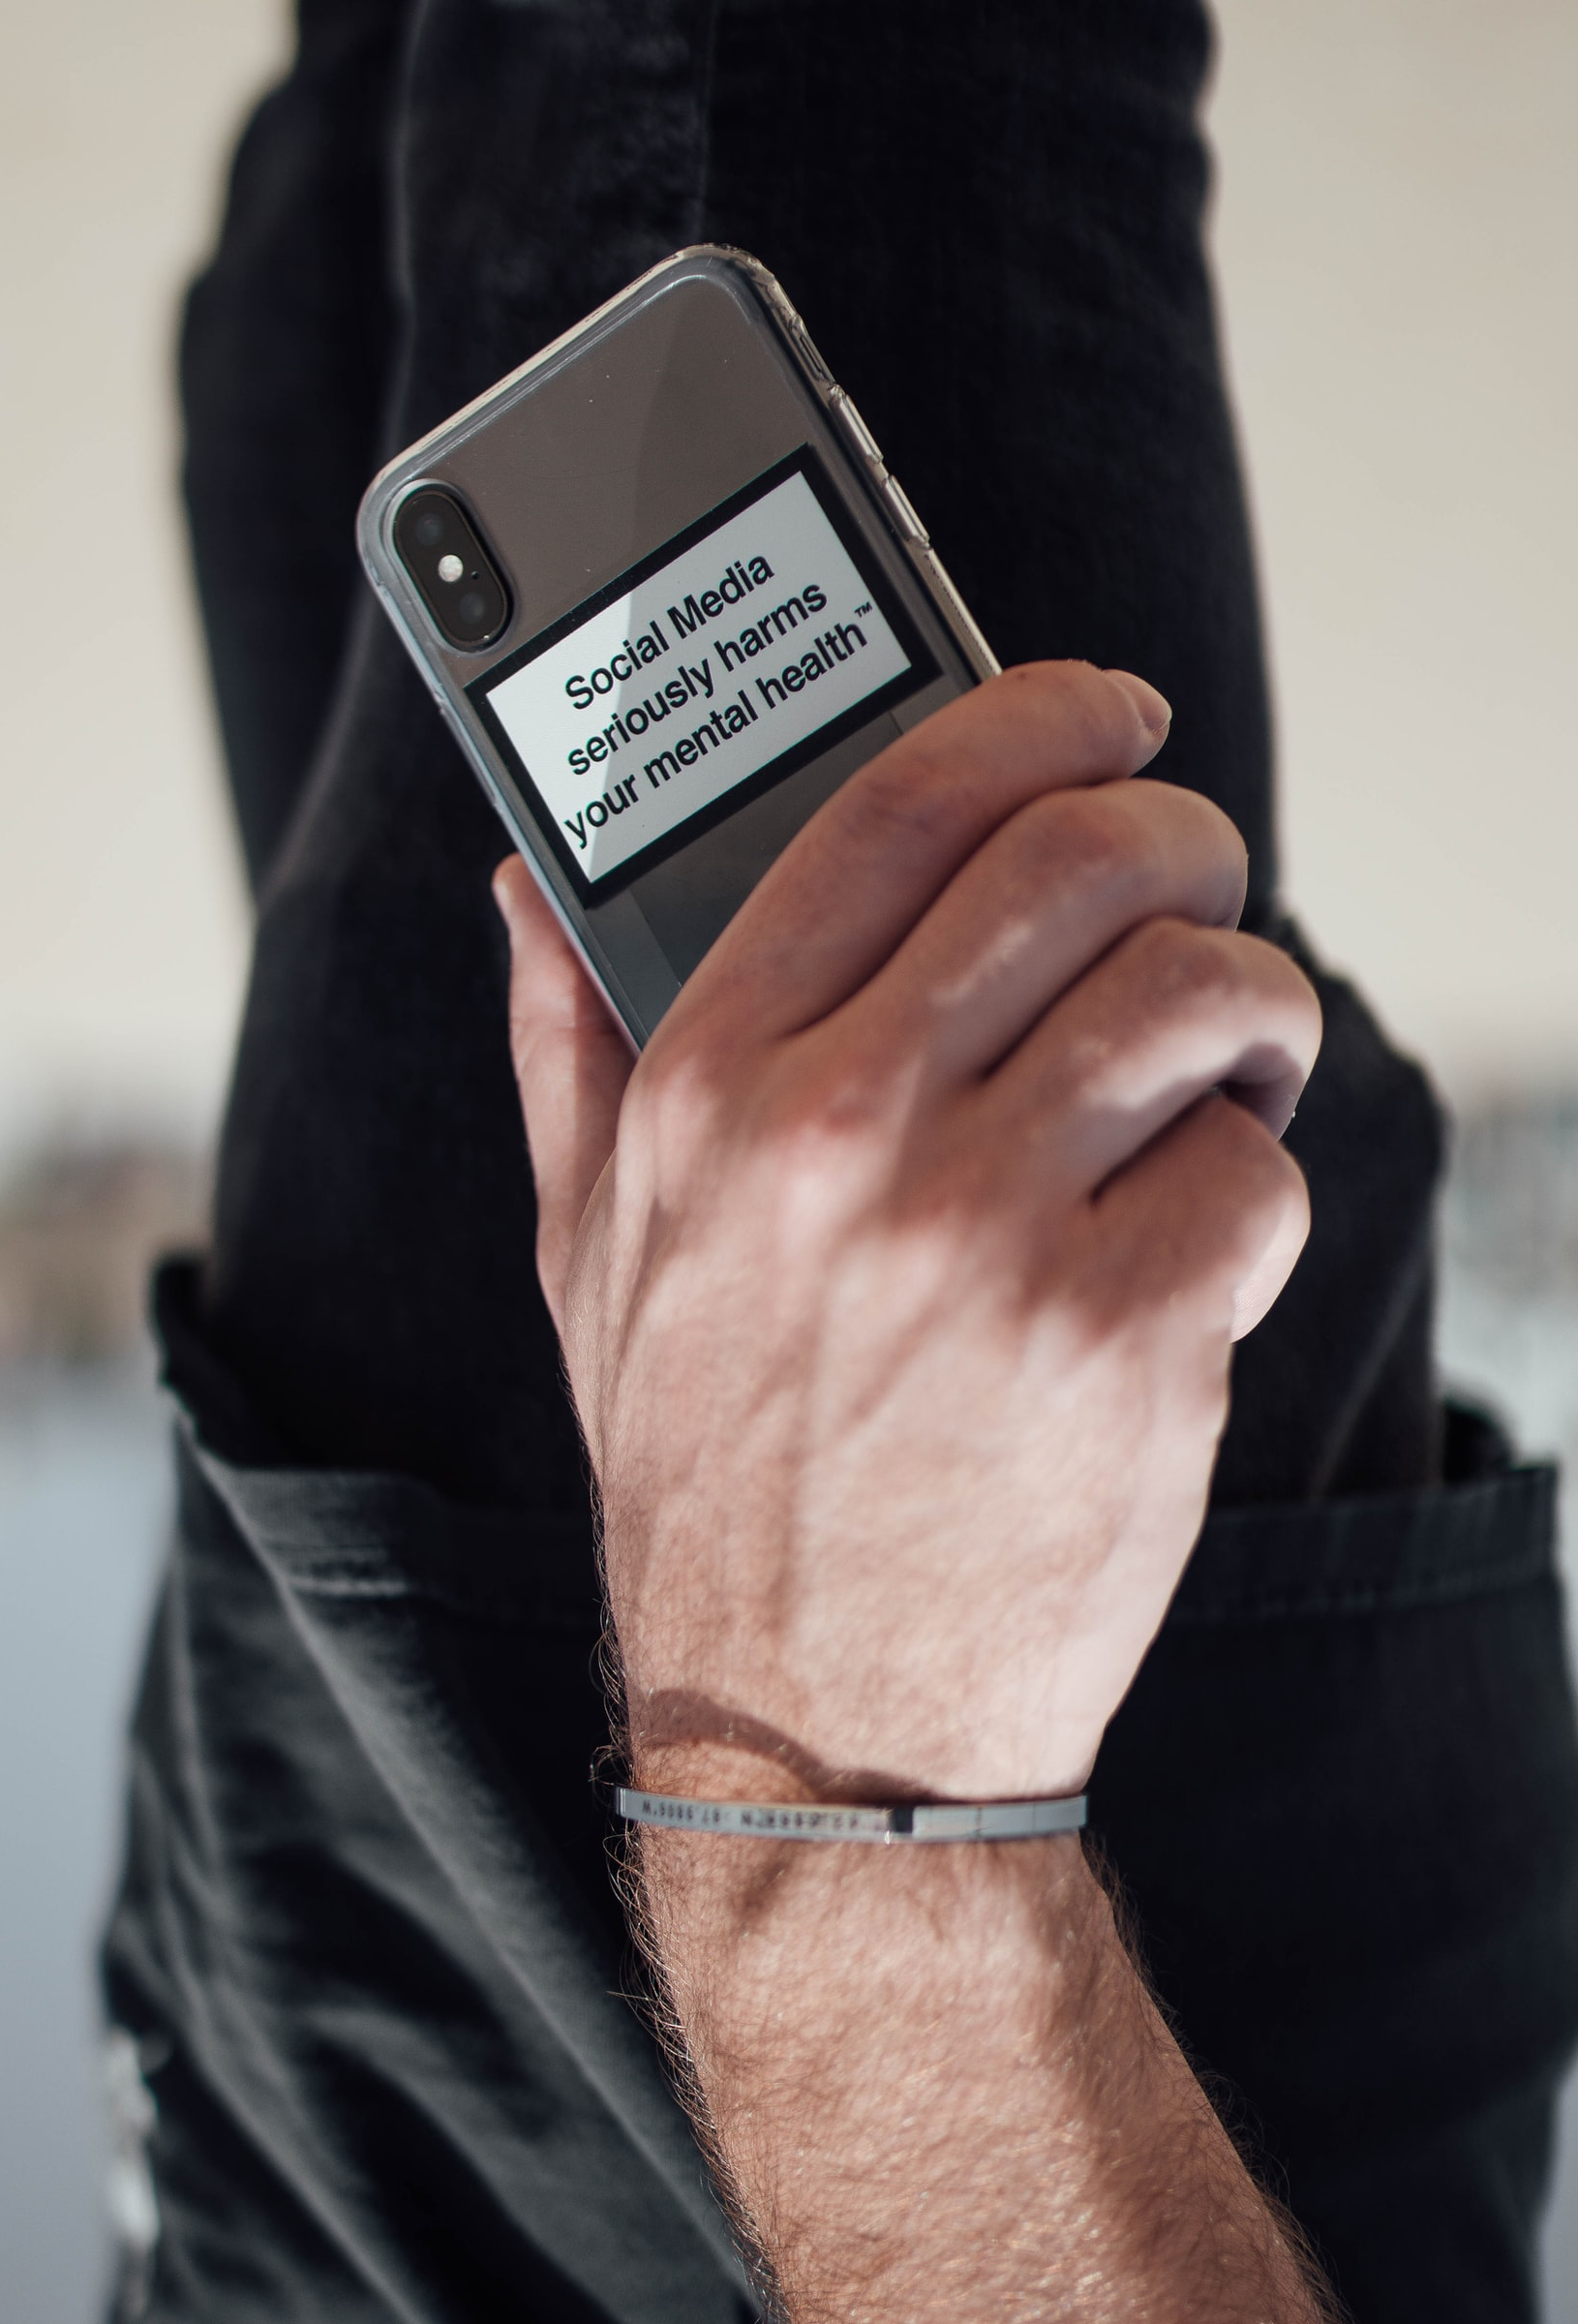
Internet
What would you accomplish if you said no more often to the internet, social media and your phone?
Photo by Christopher Ott on Unsplash
Notes:
Could you take a day without your phone, the internet, Netlfix and social media? How about any electronic games you may play? Could you do it for a week? A month? Would you be enriched?

Slide 22
Stuff is Part of the Problem
Clutter Affects your life
Not all clutter is physical
Clutter and stuff can lead to weight issues
Overconsumption is killing the Earth
We can still be miserable after buying stuff
You cannot relax if you are dealing with moving/cleaning your stuff
We go into debt to buy stuff we don’t need
Clutter is stressful
“The less we let in, the less we have to let go.” —Joshua Fields Millburn
Millburn, J. F. (2019, October 27). The Minimalists on Twitter. Twitter. https://twitter.com/theminimalists/status/1188485768542670848

Slide 23
Some Solutions for Physical Stuff
90/90 Rule Look at a possession. Pick something.
Anything. Have you used that item in the last 90 days? If you haven’t, will you use it in the next 90? If not, then it’s okay to let go . https://www.theminimalists.com/ninety/
20/20 Rule - Anything we get rid of that we truly need, we can replace for less than $20 in less than 20 minutes from our current location. https://www.theminimalists.com/jic/
Scanning Party- Scan your photos and documents. https://www.theminimalists.com/scanning/
Packing Party- Pack all your stuff up like you are moving. Only take out what you need. You likely will not miss the rest. https://www.theminimalists.com/packing/
30 Day Challenge Game – Get rid of 1 item 1st day of the month, 2 items 2nd day… https://www.theminimalists.com/game/
Project 333 - Only having 33 items of clothes for 3 months. https://bemorewithless.com/project-333/

Slide 24
Action Plan
Alanson and White, (2017) advocate for creating an action plan:
What is one goal you have to practice minimalism and/or essentialism?
Who can help you achieve this goal and/or hold you accountable?
What is one commitment that doesn’t add value?
Identify strategies to help you get started:
  … this week
  … this month
  … this year
Alanson, E.,& White C. (2017). Minimalism: Teaching and Practicing the Pursuit of Less [PowerPoint presentation]. Retrieved from NACADA Website: http://http://apps.nacada.ksu.edu/conferences/ProposalsPHP/uploads/handouts/2017/C230-H01.pdf

Slide 25
Don’t go too cheap:
Spending more to get less?
The trouble with minimal living is that, though it can be joyful, rich and creative, it isn’t easy and we often have to spend more to achieve it.

Slide 26
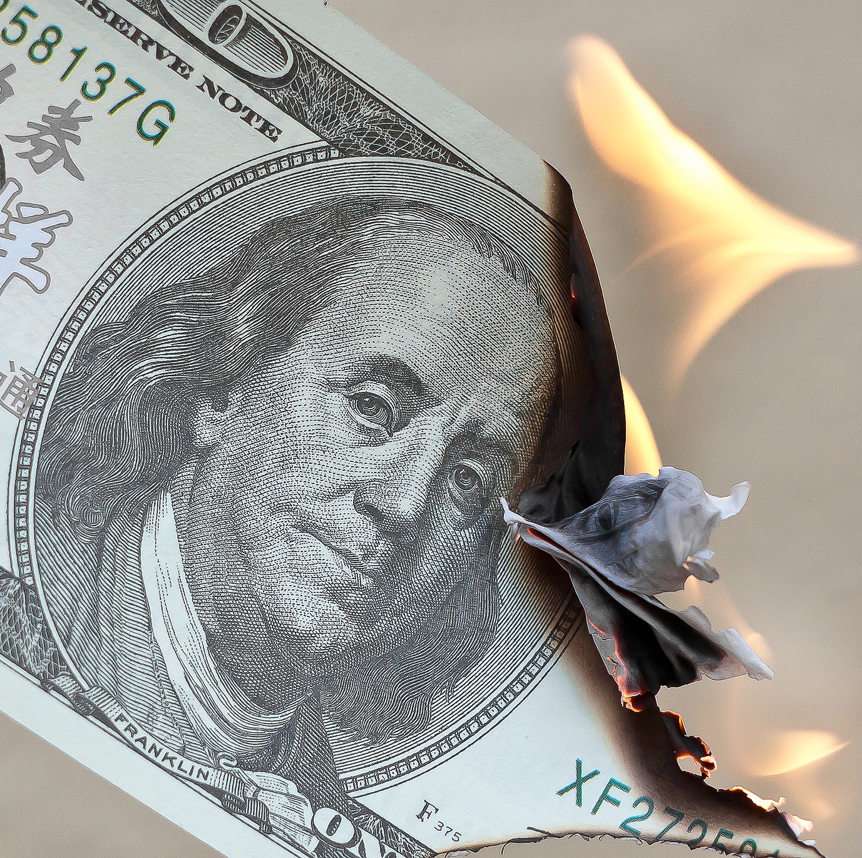
Not paying for anything you don’t use
Image by Foto-Rabe from Pixabay

Slide 27

Easy Access
Uncluttered Desktop
Files easily accessible in the cloud.
Box
Google Drive
Amazon Photos
Photo by Sigmund on Unsplash
Notes:
Could you take a day without your phone, the internet, Netlfix and social media? How about any electronic games you may play? Could you do it for a week? A month? Would you be enriched?

Slide 28
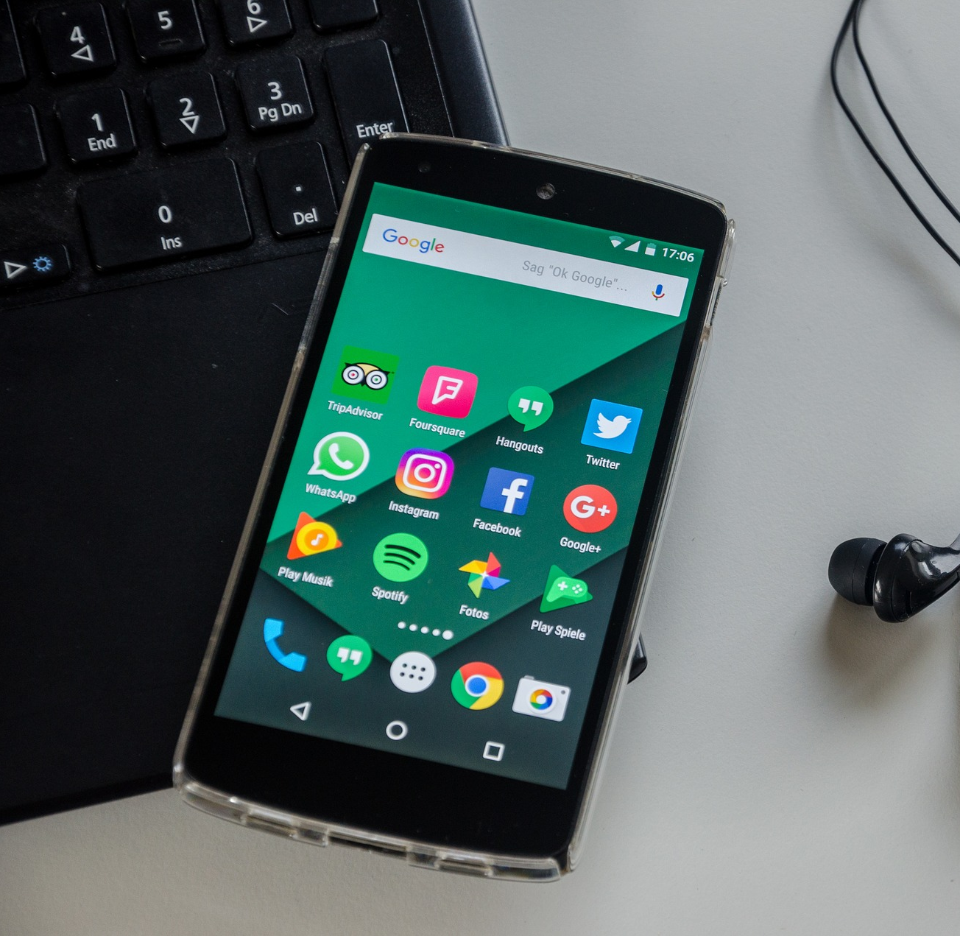
Get more out of the tools than the tools get out of you.
Image by USA-Reiseblogger from Pixabay

Slide 29

This is all great, but what does it
have to do with advising?
Photo by Kari Shea on Unsplash
Notes:
Every advising appointment a blank page

Slide 30
Ways of Being a Minimalist
Fewer More Meaningful Projects
Reduce Clutter & Consumption
Back to the Basics
Eat better
Based on values and passions
Help those who need it most
Notes:
Every advising appointment a blank page

Slide 31
Resources
Merriam-Webster. (n.d.). Minimal. Merriam-Webster. https://www.merriam-webster.com/dictionary/minimal.
Alanson, E.,& White C. (2017). Minimalism: Teaching and Practicing the Pursuit of Less [PowerPoint presentation]. Retrieved from NACADA Website: http://http://apps.nacada.ksu.edu/conferences/ProposalsPHP/uploads/handouts/2017/C230-H01.pdf
McKeown, Greg (2014). Essentialism: the disciplined pursuit of less. New York: Crown Business.
Nicodemus, R. (n.d.). Ryan Nicodemus's Blog, page 42. Goodreads. https://www.goodreads.com/author/show/5235290.Ryan_Nicodemus/blog?page=42.
Nicodemus, R. (n.d.). Ryan Nicodemus's Blog, page 46. Goodreads. https://www.goodreads.com/author/show/5235290.Ryan_Nicodemus/blog?page=46.
Millburn, J. F. (2019, December 7). This year beat the crap out of me and it was awesome. The Minimalists. https://www.theminimalists.com/awesome/.
Nicodemus, R. (n.d.). Ryan Nicodemus's Blog, page 41. Goodreads. https://www.goodreads.com/author/show/5235290.Ryan_Nicodemus/blog?page=41.
Millburn, J. F. (2019, October 27). The Minimalists on Twitter. Twitter. https://twitter.com/theminimalists/status/1188485768542670848
Millburn, Joshua Fields & Nicodemus, Ryan (2011). Minimalism: Live a Meaningful Life. Asymmetrical Press.
Wright, Colin. "Minimalism Explained." Exile Lifestyle. 15 Sept. 2010. Web. 12 Jan. 2017.

Slide 32
Resources Continued
Nicodemus, J. F. M. R. (2019, August 15). 90/90 Minimalism Rule. The Minimalists. https://www.theminimalists.com/ninety/
Nicodemus, J. F. M. R. (2019a, August 7). Getting Rid of Just-in-Case Items: 20 Dollars, 20 Minutes. The Minimalists. https://www.theminimalists.com/jic/
Millburn, J. F. (2019a, August 16). Photo-Scanning Party. The Minimalists. https://www.theminimalists.com/scanning/
Nicodemus, R. (2019, August 27). Packing Party: Unpack a Simpler Life. The Minimalists. https://www.theminimalists.com/packing/
Nicodemus, J. F. M. R. (2020, February 3). Play the 30-Day Minimalism Game. The Minimalists. https://www.theminimalists.com/game/
Carver, C. (2021, September 6). Project 333. Be More with Less. https://bemorewithless.com/project-333/
Nicodemus, J. F. M. R. (2019a, August 3). Minimal Maxims. The Minimalists. https://www.theminimalists.com/minimalmaxims/

Slide 33
Photo Sources
Grabowska, K. (2015, May 15). Less is more [Photograph]. https://pixabay.com/photos/less-is-more-quote-white-sentence-791109/
Holden, C. (n.d.). Studio Update: Valspar Paint. Retrieved December 12, 2017, from http://inspiredbarn.com/2013/01/studio-update-valspar-paint/
Sikupela, T. (2020, July 10). [Railway in South Africa]. https://unsplash.com/photos/ZC3iqcOL5T8
Girardet, E. (2021, March 10). All you need is less [Photograph]. https://unsplash.com/photos/fti002hQCCA
Jordan, B. (2021, August 8). [Brown wooden blocks]. https://unsplash.com/photos/ofpr9Cw8Rj8
Sørby, H. (2015, January 26). [Snowy Tree Landscape]. https://pixabay.com/photos/treet-sn%c3%b8-vinter-landskapet-hvit-610893/
Ott, C. (2020, July 6). Social media seriously harms your mental health [Photograph]. https://unsplash.com/photos/hgGLolfrGyQ
Foto-Rabe. (2019, August 21). [Money burning]. https://pixabay.com/photos/money-burn-dollar-waste-finance-4418858/
Sigmund. (2021, March 8). [Laptop with plants]. https://unsplash.com/photos/13aN_pn10wk
USA-Reiseblogger. (2016, October 13). [Cell phone with headphones]. https://pixabay.com/photos/smartphone-notebook-social-media-1735044/
Shea, K. (2018, August 20). Clear framed eyeglasses on top of books [Photograph]. https://unsplash.com/photos/apcUIqOPEIo

Slide 34
“Love people and use things because the opposite never works.” The Minimalists

Slide 35
Questions and Discussion?

