Slide 1
Time Management for Creatives: Seize the Day Before the Day Seizes You.
By: Todd Spinner
toddspinner.com

Slide 2
Hello!
I am Todd Spinner
Academic Advisor
School of Chemical Sciences
You can find me on Twitter @tspinner or toddspinner.com

Slide 3
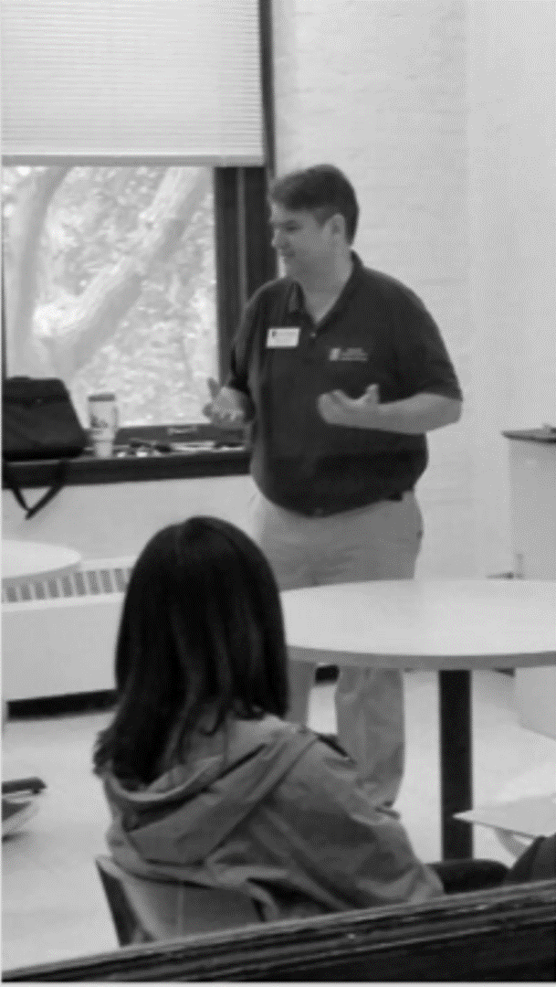
My Creative Works
Notes:
My First Webpage designed in 1995.
Since then, I have designed pages for St. Michael’s College in Vermont, Adrian College, DePauw University, University of Illinois: Financial Aid Office, College of Education and School of Chemical Sciences. I also have done freelance work for The Morrigan Company, High Caliber Training Center, The Bike Project and many others.
Currently working as an Academic Advisor and manage the Web and Social Media for the School of Chemical Sciences Advising.
I also teach a Career and Life Skills course at the University of Illinois as well as am an Illinois Certified Career Coach.

Slide 4
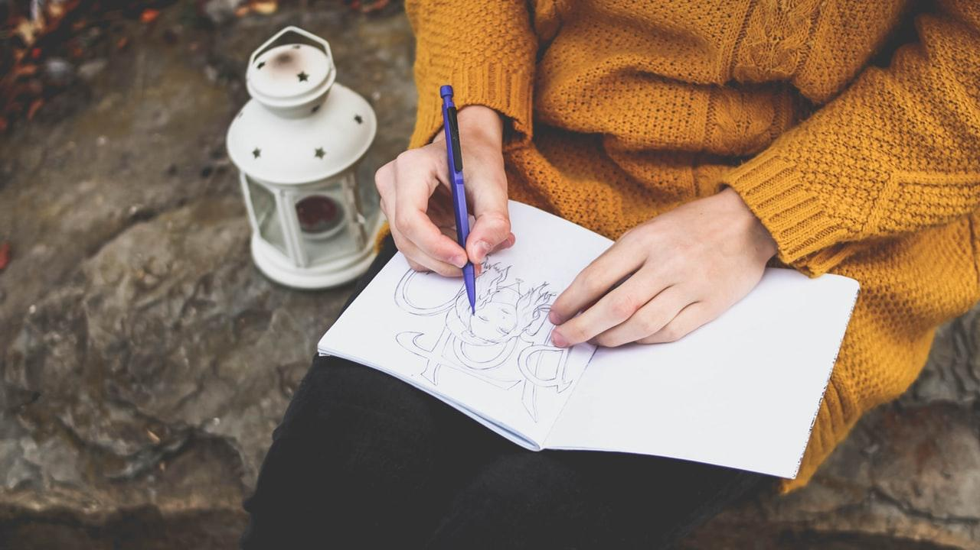
My Story
Notes:
My Story
I would love to stand here in front of you and say that I am a time management guru. However, that would be a fabrication and a ruse. I have struggled my entire life with being organized.
For reference, I remember a time before the internet was truly a household thing. I remember dialing into Bulletin Board Systems as a kid in the 1980s. I remember AOL. I was not a stranger to hearing the connection of a telephone modem and praying that I got connected and had a good connection as close to 56k as possible. I remember a time as a student at Eastern Illinois University in 1993 and getting an email that there was this new tech out there developed at the University of Illinois called Mosaic. Sounded interesting but brushed it aside. Little did I know what a watershed moment that was in hindsight. Almost everything we are going to talk about today is made possible due to that development in some way or another.
I remember when I was in college flying by the seat of my pants. This was before all the online syllabi and Learning Module Systems. In my worst example of time management, I went to dinner with friends and then at 6 pm went to the library and grabbed every book on Peter the Great. Remember, this was in the infancy of the World Wide Web in 1994. You actually had to go to a library. In-person. I could barely carry them. I spent the entire night completing a 20-page paper for my Russian History class. Got an A too which helped reinforce my bad habits.
It is possible that my bad habits were also backed up by my former life as a journalist. I worked better on a tight deadline.
I have always been in search of the perfect system of time management. I remember spending much of the late 1990s and early 2000’s trying various PDAs (remember Personal Digital Assistants or am I just showing my age?) I also like to go to Barnes and Noble and get a nice bound planner, but all of these were not really able to connect to my University's calendar of choice. I did find a nice flip “smartphone” that was able to connect to Outlook when I was working for the U of I circa 2006-2007. This was of course pre- iPhone and Android days.
Flash forward to today. We are blessed with so many digital and analog time management devices and methods. Many of them are free. There are fewer and fewer excuses for not managing your time well. There are still pitfalls. We can still be oversubscribed and short-handed. We can still procrastinate. Let’s start our journey to Seizing the day before it seizes us.

Slide 5
Content
The pressure to create content is increasing.
https://siteefy.com/how-much-data-and-content-is-created-every-day/

Slide 6
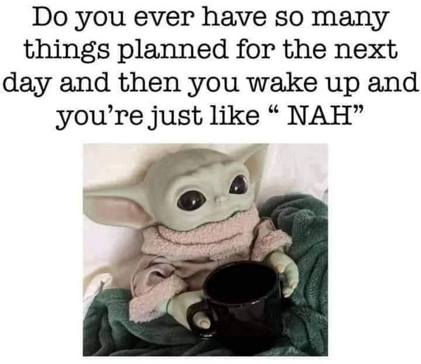
Pressure, burnout…
If you only had more time.
https://twitter.com/teachergoals/status/1510684414770040836/photo/1
Notes:
Content
A single person creates 1.7MB of data per second.
The amount of data is growing exponentially. Today, our best estimates suggest that at least 2.5 quintillion bytes of data is produced every day (that's 2.5 followed by a staggering 18 zeros!).
and we produce 2.5 quintillion data bytes each day.
Google, Amazon, Facebook, and Microsoft combined store 1,200 petabytes of data.
Skype has 3 billion minutes of calls per day.
5 billion Snapchat videos and photos are shared per day.
333.2 billion emails are sent per day.
Users upload 500 hours of video on YouTube per minute according to YouTube’s Official Blog. An average user, aged 18 and above spends 41.9 minutes a day on YouTube. This includes all devices, desktop, laptop, mobile, etc.
•By 2025, 200+ zettabytes of data will be in cloud storage around the globe.

Slide 7
Time Management
Who Feels like they have Good time management?
01
Who Needs work on Time Management?
02
Why is this important?
03

Slide 8
What kinds of time management issues are you experiencing?

Slide 9
“We believe we don't have enough time when really we don't have enough focus.”
Mark Manson, Author
Notes:
Redefine productivity, it’s not about how much you get done, it’s about the impact that you’re having.

Slide 10
1. We Own All of Our Time
If you don’t have time to do something, it’s not a priority.
Notes:
We Own our Time
At any given moment, you are doing what you must want to be doing.
Time is entirely within your control.
I don’t have time… actively choosing to not do something.
If you do not have time to do something, then it is not a priority.
Not doing something is fine, but don’t make excuses that you don’t have the time.
Look at doing a time audit. If you use your phone, get an app that shows where you spend your time and how long.

Slide 11
2. Hell Yes or Hell No
Notes:
Book by Derek Sivers The default should be NO.
Only do things that really excite you.
Don’t say yes to “kind of” or “meh”
Younger folks can say yes more often. As you get older, you will have to do more to limit your YES.

Slide 12
3. Daily Highlight
Notes:
Book “Make Time” – Jake Knapp and John Zeratsky
Everyday… One thing is my highlight. It is the only thing that must get done.
The most fun, urgent or exciting usually is my daily highlight.

Slide 13
4. Use a To Do List
Paper or Electronic?
Notes:
This can be Paper or Electronic.
We are great at coming up with ideas. Our brains are not so good at holding on to them. Write them down or forget them.
My favorite to-do list is on index cards. I also use Todoist.com which has a great free option and will remind you and also gamify things a bit if you start crossing off your items.
Caution on making unrealistic to-do lists or lists that are too long.
While to do lists can help some, they tend to get over-burdened with too many items on the list and items that never get done.
If you use to do lists, a great online resource/app is todoist.com which has a good free level. Works on your Desktop and phone.

Slide 14
5. Parkinson’s Law
Work expands to the time allocated to complete it. Leverage artificial deadlines
Notes:
Work Expands to the time allocated to complete it.
Create artificial deadlines
Helps prevent procrastination.

Slide 15
6. Protect your Time
Set aside time to be productive.
Notes:
Set aside time to be productive.
Helps to prevent the hijacking of your time. How many times does this happen to you?

Slide 16
7. Consistency
Start and end your day at the same time every day.
Notes:
We’re creatures of routine.
I get up at 6:50 am every day, even on weekends.
Still struggle to go to bed at a consistent time but that is important.
Sleep is important to productivity.
This is where I envy my hardworking farming grandparents who were up before dawn every day but went to bed after the weather report on TV.

Slide 17
8. Delegate
Delegation $ worth of your time. Outsource, technological improvements – Automated Scheduling
Notes:
How much is your time worth?
Can’t do it all.
Can you hire out the work? Part-time, student workers, etc.
New Tech can also help. Think Hootsuite, Buffer, AirTable, etc.
Microsoft Bookings - No back and forth.

Slide 18
9. Ambiance
Make creative triggers, such as music and surroundings, part of your routine.
Notes:
You should set up your creative and productive space.
I tend to like either instrumental music or some ambiance track.
It could be nature, Hogwarts, or a storm. It could be techno coding music or a pan flute. Depends on the mood.
Sometimes I like to change the lighting. Make it darker or let in more light.
You should look at minimizing your workspace. Get rid of clutter. It will make things much more organized and less stressful.
Control your environment or the environment will control you.

Slide 19
10. Zero Inbox
Set aside time to answer dreaded email.
Notes:
333.2 billion emails are sent per day and you feel that half of them are in your inbox.
Take action after every message you read. Try not to handle most messages more than once.
Delete unnecessary conversations.
Keep in folders or process the others.
Get your emails to zero or near zero each day.
Keeps you organized and reduces feelings of overload.
The Great Unsubscribe. Try unsubscribing as much as you can. Much less clutter. I noticed Gmail is suggesting unsubscribing if you have not opened the email from a sender very often. Take them up on that.

Slide 20
Build Your Routine, Find Your Focus, and Sharpen Your Creative Mind
Manage Energy not time
Start and End your day right
The Choice to be Satsfied
Prioritize creative work during times when your energy levels are at their high-
est.
Start and end your day at the same time every day.
1
2
3
Notes:
Manage Energy not time
Prioritize creative work during times when your energy levels are at their highest.
Start and End your day right
Start and end your day at the same time every day.
The Choice to be Satisfied
You have a choice whether to be satisfied or dissatisfied. It is ok if you only got one video or graphic post made.
We often do not recognize how hard it is to create content or code. Be kind to yourself.

Slide 21
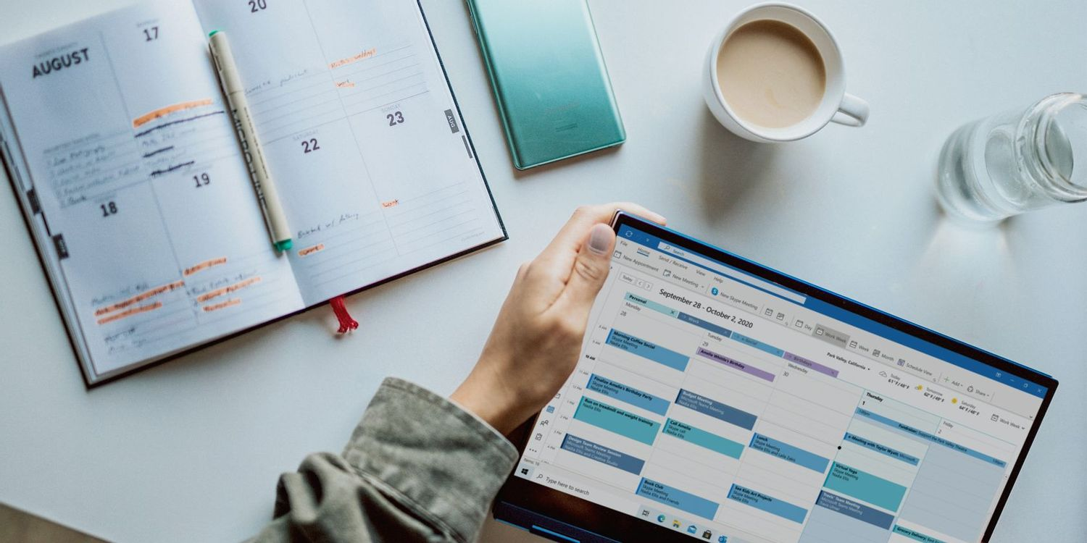
Time Batching
https://www.goskills.com/Office-Productivity/Resources/Time-batching?utm_source=pocket_mylist
Notes:
Time Batching
Time batching is a time management technique that includes grouping similar tasks together and setting aside a time to complete them all or work on them until a predetermined point of progress. The purpose of time batching is to minimize distractions for a workflow that enables concentration, attention to detail, and productivity.
So for example. I will set aside a half-hour to work on social media. I may make several posts, but when that time is complete, I will move on to other planned tasks.

Slide 22
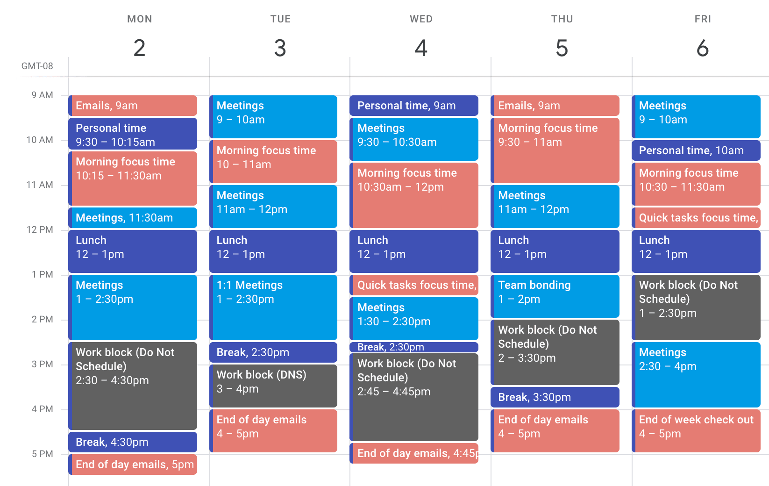
Time Boxing
https://www.spica.com/blog/timeboxing?utm_source=pocket_mylist
Notes:
What is timeboxing?
Timeboxing simply means that you open your calendar and enter a block of time that you’ll spend on a certain task in the future.
Instead of working on the task until it’s done, you proactively decide how much time you’ll spend on it and when (and even where).

Slide 23
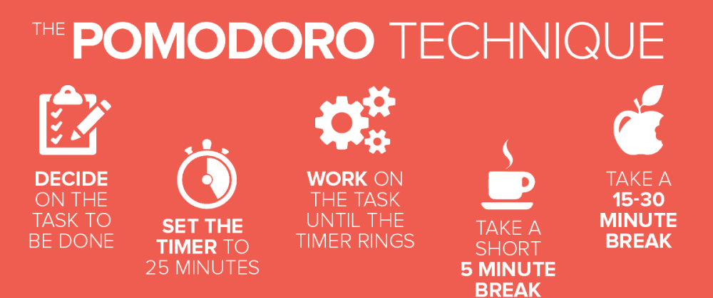
Pomodoro
https://dev.to/moesmp/pomodoro-a-technique-to-rescue-your-eyes-as-a-software-developer-4865
Notes:
The Pomodoro Technique
The Pomodoro Technique was developed in the late 1980s by then university student Francesco Cirillo. Cirillo was struggling to focus on his studies and complete assignments. Feeling overwhelmed, he asked himself to commit to just 10 minutes of focused study time. Encouraged by the challenge, he found a tomato (pomodoro in Italian) shaped kitchen timer, and the Pomodoro technique was born.
Its biggest strength is its simplicity:
Get a to-do list and a timer.
Set your timer for 25 minutes and focus on a single task until the timer rings.
When your session ends, mark off one pomodoro and record what you completed.
Then enjoy a five-minute break.
After four Pomodoros, take a longer, more restorative 15-30 minute break.
The 25-minute work sprints are the core of the method, but a Pomodoro practice also includes three rules for getting the most out of each interval:
Once a pomodoro is set, it must ring. The pomodoro is an indivisible unit of time and can not be broken, especially not to check incoming emails, team chats, or text messages. Any ideas, tasks, or requests that come up should be taken note of to come back to later. A digital task manager like Todoist is a great place for these, but pen and paper will do too.
I have taught this to my students using a 45-minute study session. While 25 minutes is a good time frame, you can vary the time of the pomodoro.
If you do a google search, there are lots of online timers and many can change the time of the Pomodoro.

Slide 24
Take Purposeful Breaks
Notes:
Take Breaks
You need to recharge. Take Breaks. Unplug, close the computer, Don’t use the phone. Take a lunch. Don’t work too late.
Take your personal time off. Don’t waste your vacation days either not taking them or working during them.

Slide 25
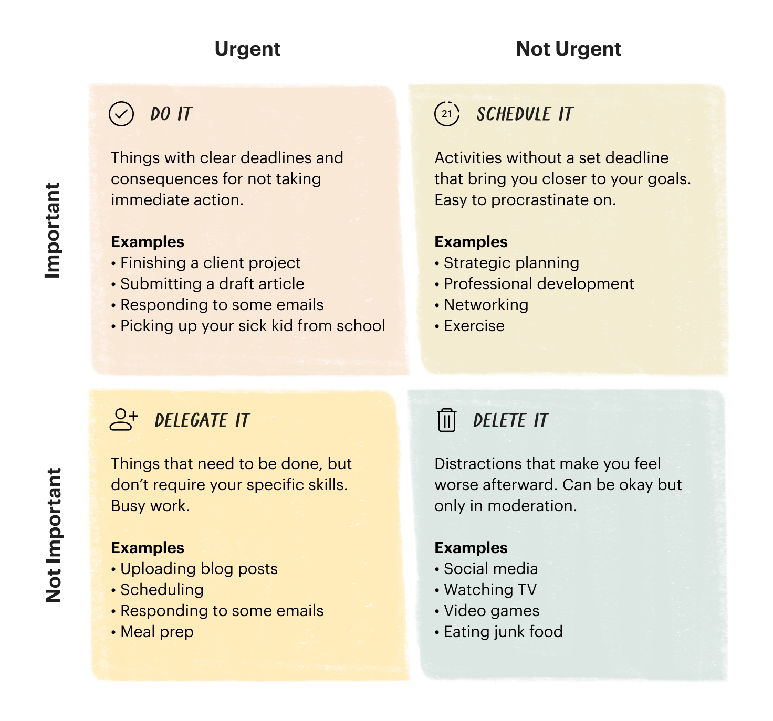
Eisenhower Matrix
https://todoist.com/productivity-methods/eisenhower-matrix
Notes:
The Eisenhower Matrix: How to prioritize your to-do list
Dwight D. Eisenhower was the 34th president of the United States, a WWII general.
Have you ever looked at your to-do list and had no idea where to even start? On top of your main projects, you have meetings to attend, an endless stream of emails to answer, and a schedule to juggle (and that’s not even accounting for your personal life!).
With all those tasks competing for your attention, it can feel almost impossible to get anything done. And the longer your to-do list grows, the harder it gets to even start. Task paralysis and procrastination are familiar beasts.

Slide 26
Minimalism
Using Minimalism to maximize our time.
Notes:
Minimalism
I did my last Webcon presentation on Minimalism 2019. It is something that I aspire to.
Do you ever wonder why it can be refreshing to stay at a hotel? You don’t have all your stuff adding to your anxiety.
If you have less stuff, less to do. Less to clean. Less stress.
Eliminate all but the essential. Unsubscribe, delete, say no. Minimize the clutter in your workspace.

Slide 27
““Art is theft.”
—Pablo Picasso
Notes:
Redefine productivity, it’s not about how much you get done, it’s about the impact that you’re having.

Slide 28
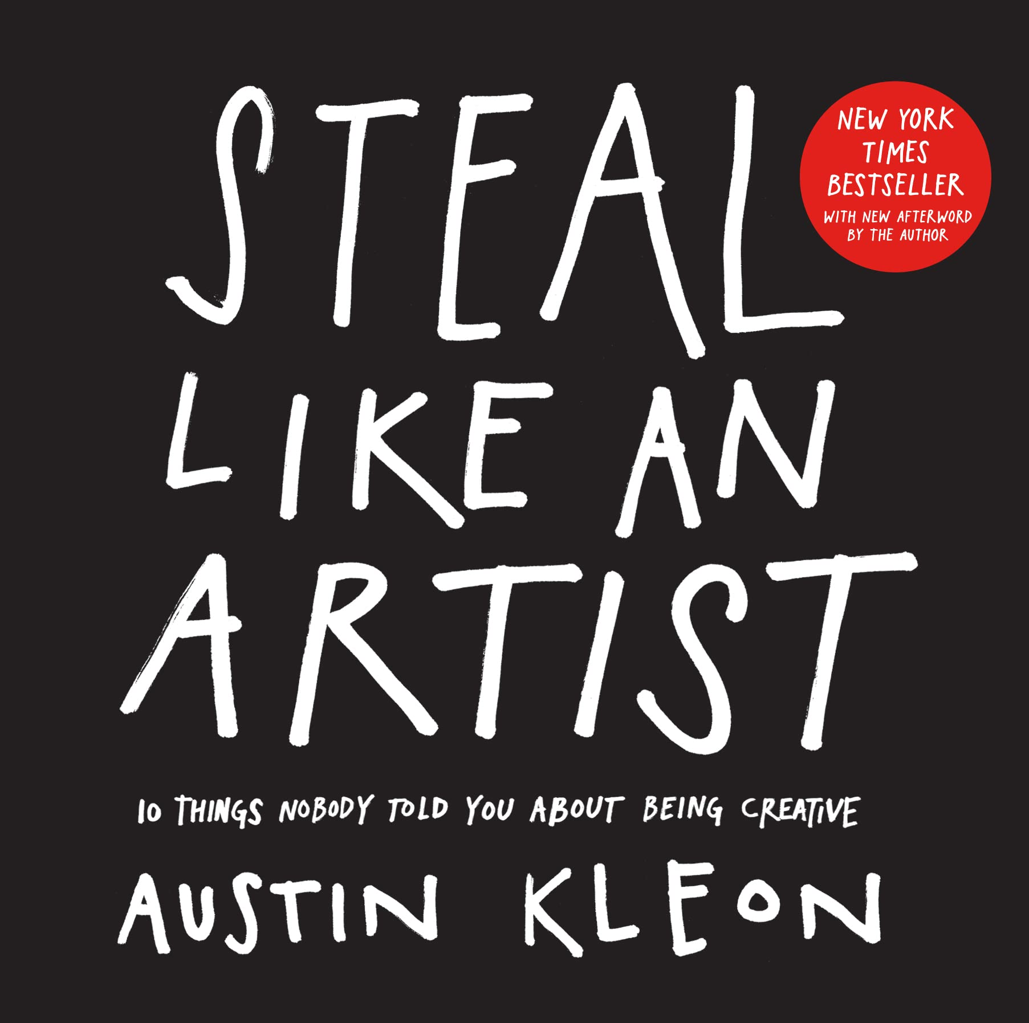
Steal Like an Artist
Very few unique ideas exist.
Notes:
Steal Like an Artist - Austin Kleon
When people call something “original,” nine out of ten times they just don’t know the references or the original sources involved.
What a good artist understands is that nothing comes from nowhere. All creative work builds on what came before. Nothing is completely original.
I was taught the CASE method in graduate school. Copy and Steal Everything.
I suggest all of Austin Kleon’s books. Steal Like and Artist, Keep Going and Show Your Work.

Slide 29
Production Pivot
You have two voices in your head. Which one are you going to listen to?
Notes:
Production Pivot
You have two voices. I call them the Lazy Voice and the Champion Voice
Which one do you listen to?
There is a difference between being busy and being productive
Busy does not equal a badge of honor.

Slide 30
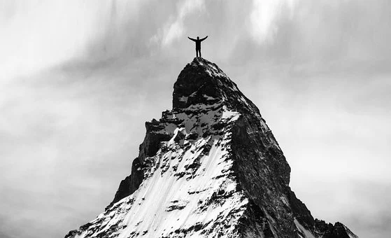
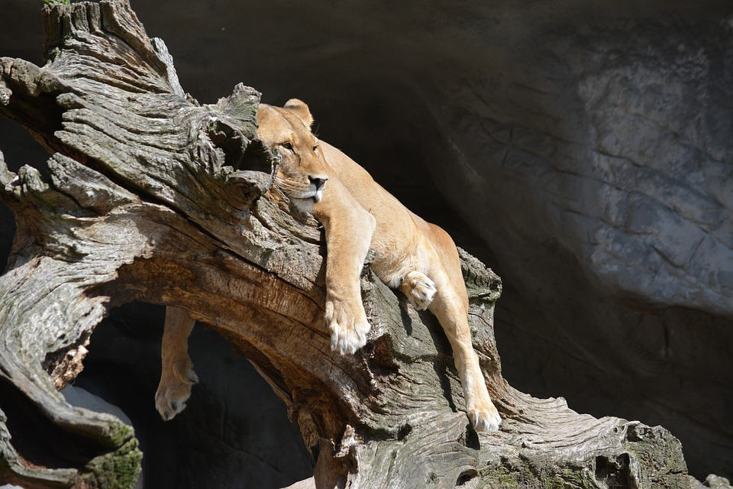
Two Voices
Champion Voice
Lazy Voice
https://pixabay.com/photos/success-man-mountain-climb-top-5941539/
https://pixabay.com/photos/animal-lioness-lazy-relax-predator-1106359/

Slide 31
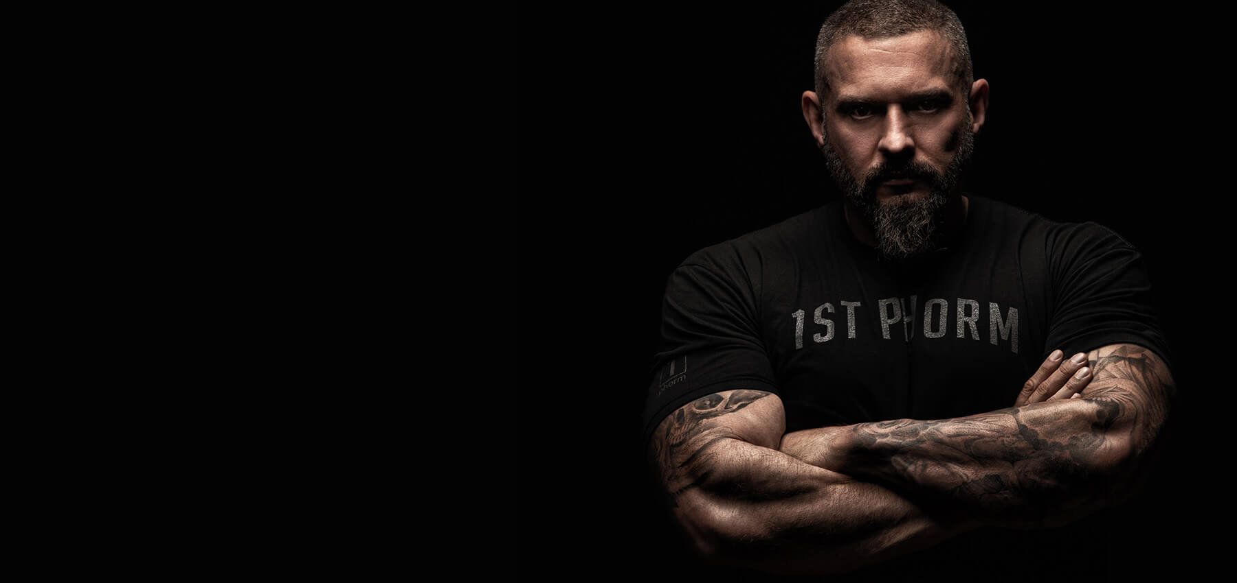
The Power List
https://andyfrisella.com/pages/about-andy-frisella
Notes:
Power List
Similar Concepts were developed by Dr. Jason Selk (St. Louis Cardinals and many professional sports and Andy Fresella
“Successful people plan and EXECUTE. Planning is important, but without execution … a plan is worthless.” Andy Fresella, 1stPhorm CEO an RealAF Podcast, 75 Hard Creator.
While Dr. Selk subscribes to the 3 item plan, Andy Fresella suggests 5 critical tasks.
This is the problem with todo lists. You cannot do 18 critical tasks.
You can omit things that are habits. You would not put brushing your teeth unless it is a problem for you.
The Basic Concept is that you need to select 5 critical tasks.

Slide 32
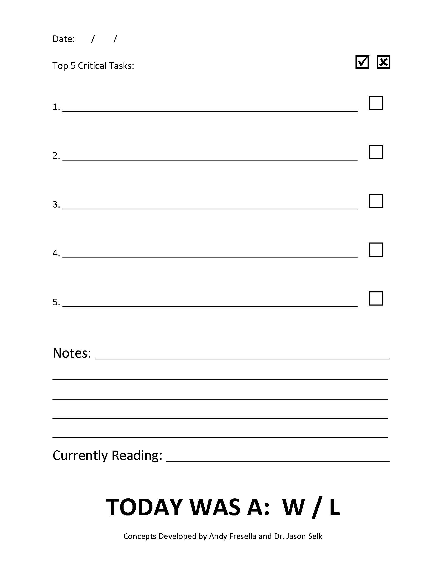

Slide 33
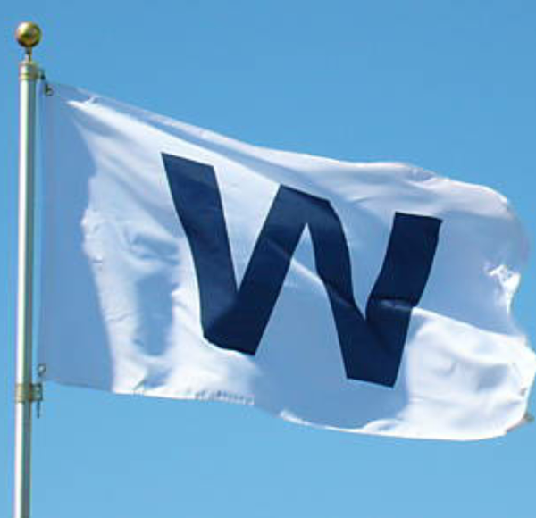
The Power List
Is your day a W or an L?
Notes:
At the end of the day, it is simply a Win or a Loss.
You should also be doing some kind of development reading on a daily basis.

Slide 34
Some of my favorite tools for time management.
Notes:
Some of my favorite Time Management Tools
Power List
Index Card todo lists
Outlook
Todoist.com (lots of time are more long term planning)
Cozi.com (Our Family Shared Calendar) Great for grocery lists.
Box.com (Unlimited Storage for University Employees) Helps clear clutter off my machine.
I love reading/watching Mark Manson, Ali Abdaal, Austin Kleon and many others who keep me on track.

Slide 35
What methods or tools do you use?

Slide 36
Thanks!
Any questions?
You can find me at:
@tspinner
spinner@illinois.edu

Slide 37
Credits
Special thanks to all the people who made and released these awesome resources for free:
Presentation template by SlidesCarnival
Photographs by Unsplash

Slide 38
Credits
undefined [Ali Abdaal]. (2021, April 18). How I Manage My Time - 10 Time Management Tips [Video]. YouTube. Retrieved September 21, 2022, from https://www.youtube.com/watch?v=iONDebHX9qk
Kleon, A. (2012, February 28). Steal Like an Artist: 10 Things Nobody Told You About Being Creative. Workman Publishing Company.
Make Time: How to Focus on What Matters Every Day. (2018b, September 25). Currency.
Frisella, A. (2020, July). 75 Hard: A Tactical Guide to Winning the War with Yourself. 44Seven Media.
Organize Tomorrow Today: 8 Ways to Retrain Your Mind to Optimize Performance at Work and in Life. (2015, December 22). Da Capo Lifelong Books.
Sivers, D. (2020, July 31). Hell Yeah or No: what’s worth doing. Hit Media.

Slide 39
Presentation design
This presentation uses the following typographies:
Titles: Mali
Body copy: Nunito
Download for free at:
https://fontstorage.com/font/cadson-demak/mali
https://www.fontsquirrel.com/fonts/nunito
You don’t need to keep this slide in your presentation. It’s only here to serve you as a design guide if you need to create new slides or download the fonts to edit the presentation in PowerPoint®

